Slide 1
Get kids moving
Simple ways to include more physical activity into your life

Slide 2
PICNIC
Prepare your own home-made goodies.
Call into a grocery store on your way.
Grab something from a local café.

Slide 3
SWIMMING
Pool or beach, plus you can take some sports gear along to play a game of cricket or grip ball.

Slide 4
DAY TRIPS
Park
Beach
Bushwalk
Playground
Zoo

Slide 5
WALK THE DOG
In the Neighbourhood
At the Dog Park
With Friends

Slide 6
NEIGHBOURHOOD FACILITIES
Sport Courts
Playground
Park
Wetlands
These spaces are great for lots of family activities – games, walks, picnics and equipment use to name a few.

Slide 7
BIKE RIDES
Explore your local area or a new area by bike. Many councils have a list of bike paths on their website.

Slide 8
BEFORE SCHOOL
Dance around the living room
Walk or ride to school
Walk the dog
Stretches or yoga

Slide 9
AFTER SCHOOL
Walk or ride home
Play a team sport
Active after school activities
Be active with friends

Slide 10
EVENINGS
Walk before or after dinner
Family dance party
Ad breaks become fitness breaks
Active games

Slide 11
PLAN
Struggling to find time to get active? Here’s a few tips to help:
Watch one less TV show.
Instead of a car, walk part of the way.
Drop into playgrounds on the way home.

Slide 12
ACTIVE PLAY - INDOORS
The floor is lava!
Dancing.
Obstacle course.
Twister.
Simon Says.
Musical chairs.

Slide 13
ACTIVE PLAY - OUTDOORS
Tag.
Hopscotch.
Playground equipment.
Obstacle course.
Riding or scooting or rollerblading.
Jumping on a trampoline.
Ball games.
Four square.

Slide 14
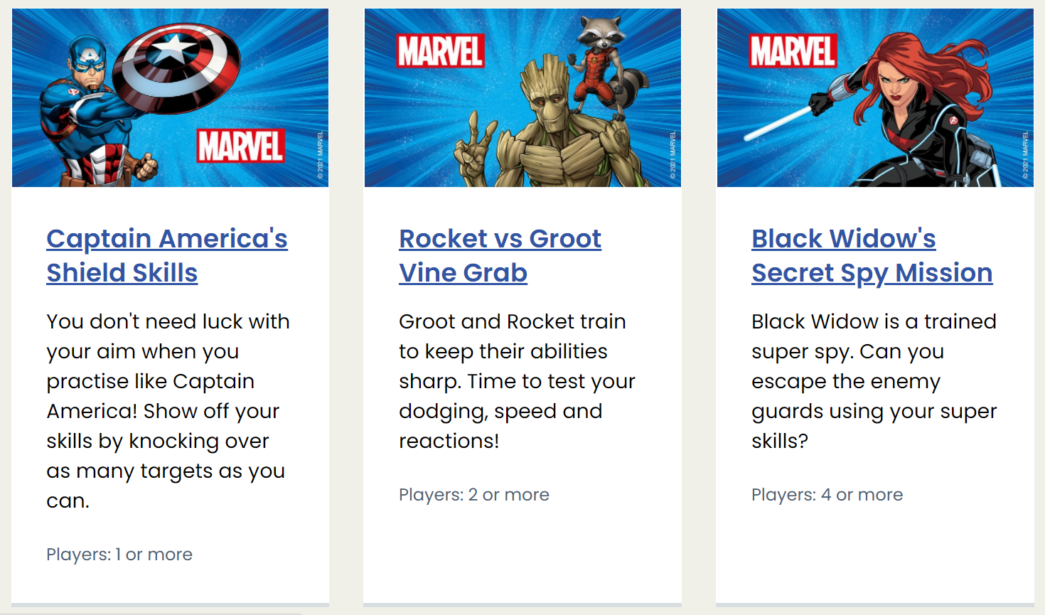
10 MINUTE SHAKE UP GAMES
https://www.nhs.uk/healthier-families/activities/10-minute-shake-up/

