Slide 1
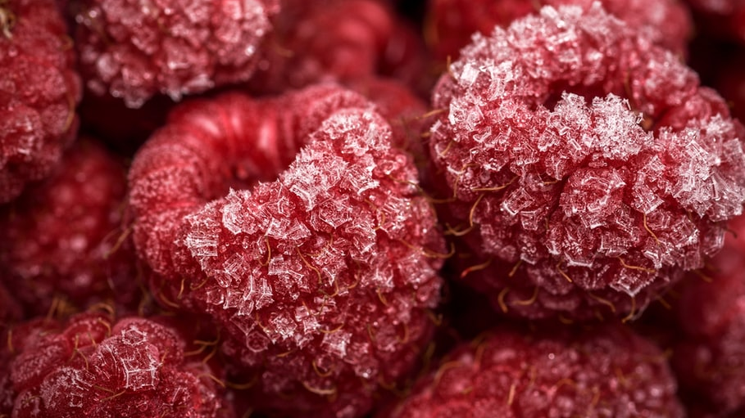

Slide 2

Use frozen fruit instead of ice cubes.
Or put fruit into the tray before covering it with water and freezing it.

Slide 3
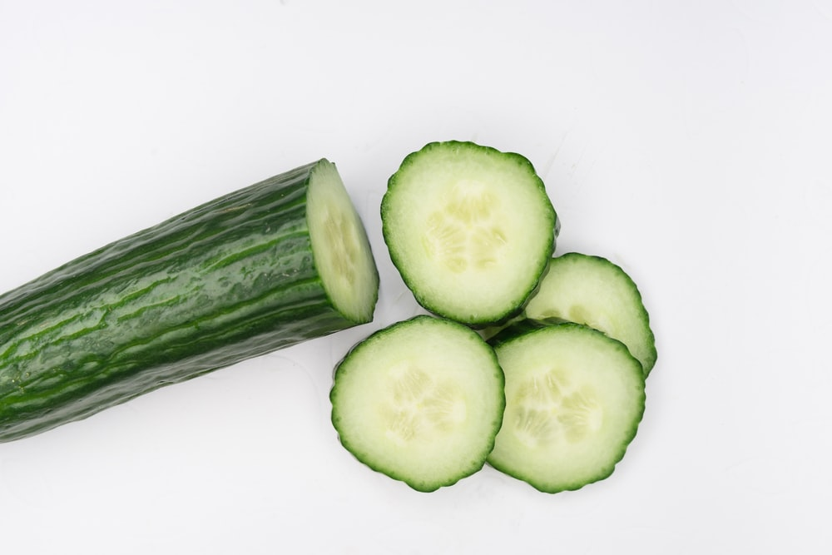

Slide 4
Add flavour to water with:
Berries
Cucumber
Lemon
Lime

Slide 5
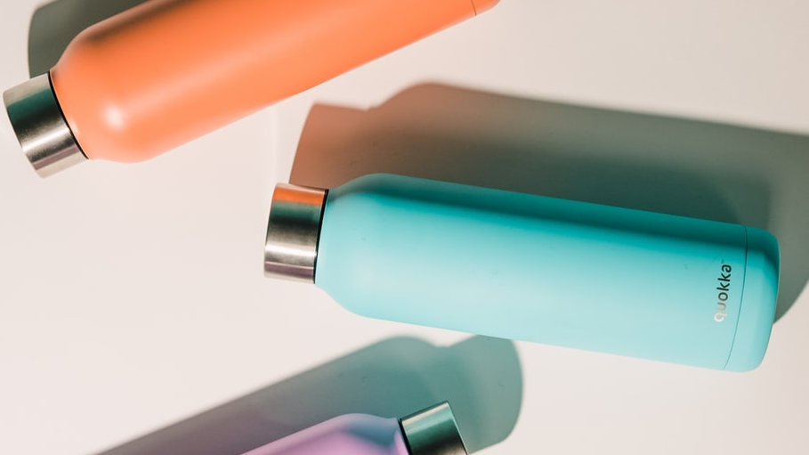

Slide 6
Give children their own special drinking cup or bottle.

Slide 7
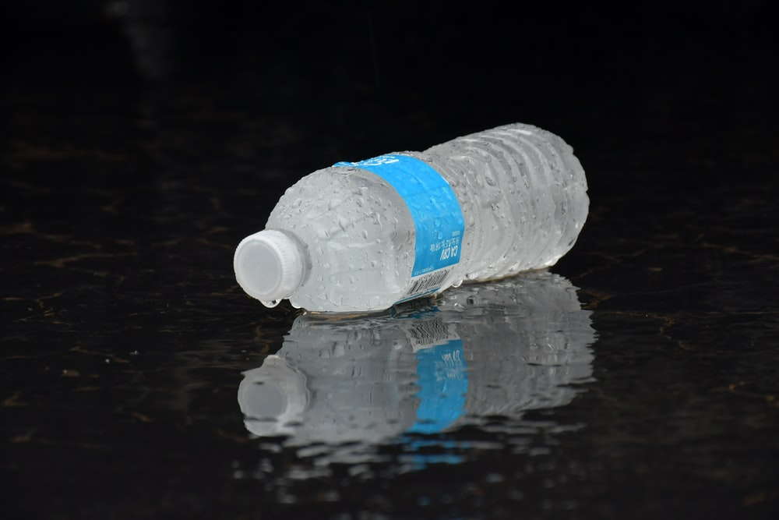

Slide 8
Buy smaller bottles that are easy for children to hold.
Reach them to refill their water bottle from the tap.

Slide 9


Slide 10
Set up a reward system for when your child drinks a designated amount of water.

Slide 11
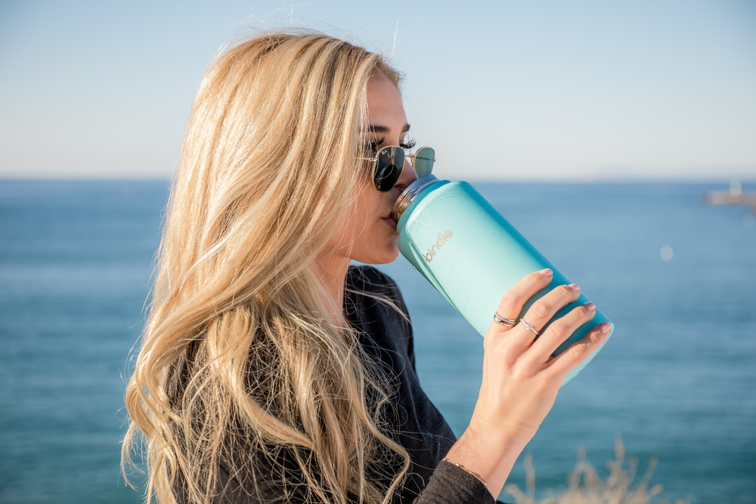

Slide 12
Be a role model; if your child sees you drinking water, they will too.

Slide 13
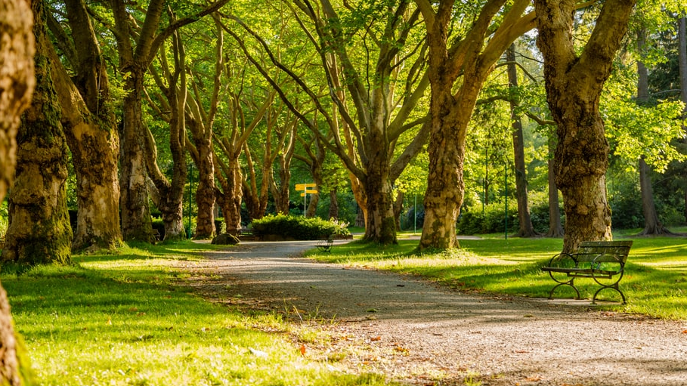

Slide 14
Carry a water bottle everywhere!

Slide 15
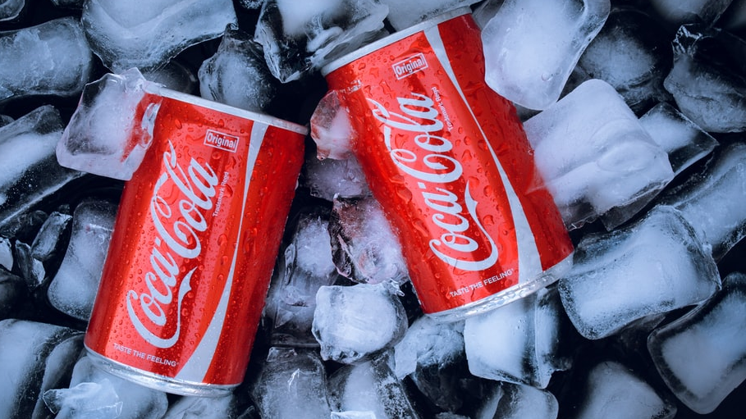

Slide 16
Substitute sugary drinks with water.

Slide 17
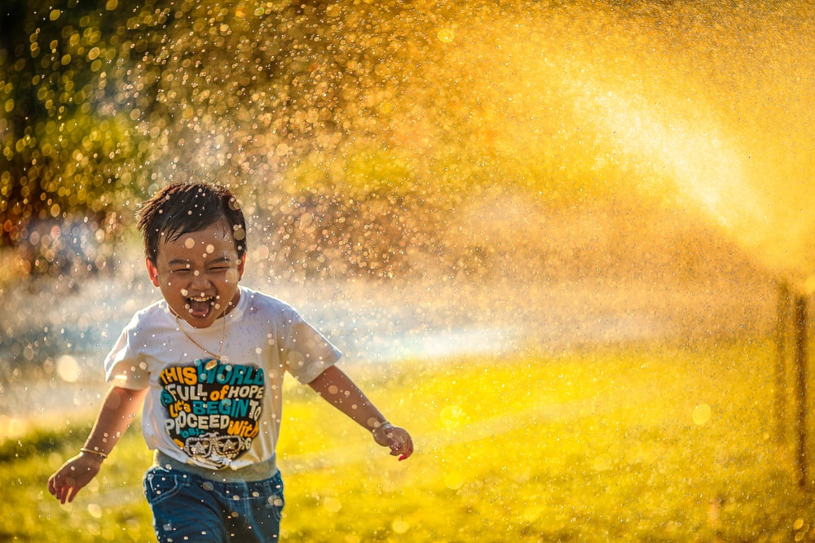

Slide 18
Make drinking water fun!
Fun cup
Turn it into a game
Silly straws
Shaped ice cube trays

Slide 19
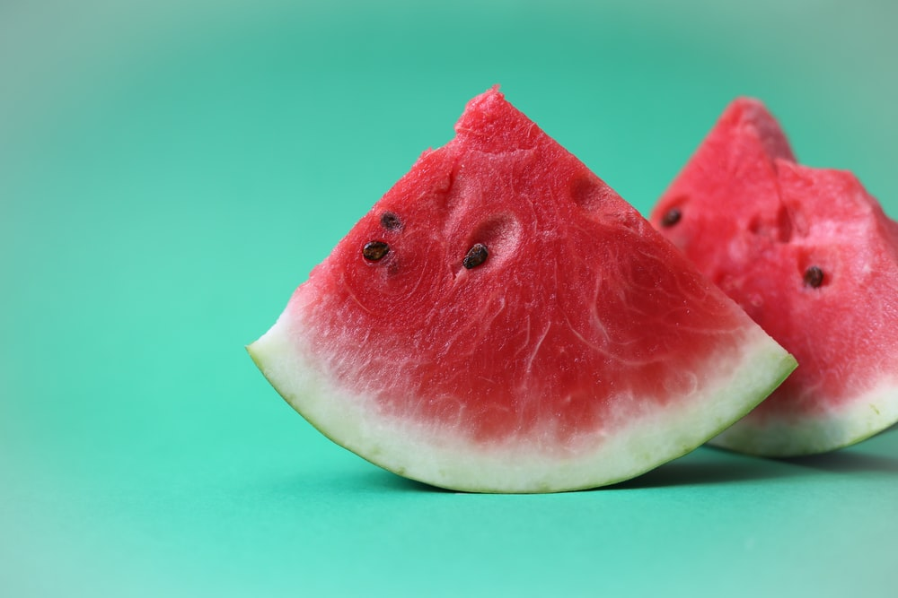

Slide 20
Eat fruit with lots of water in it!
Watermelon
Rockmelon
Strawberries
Blueberries
Grapefruit

Slide 21
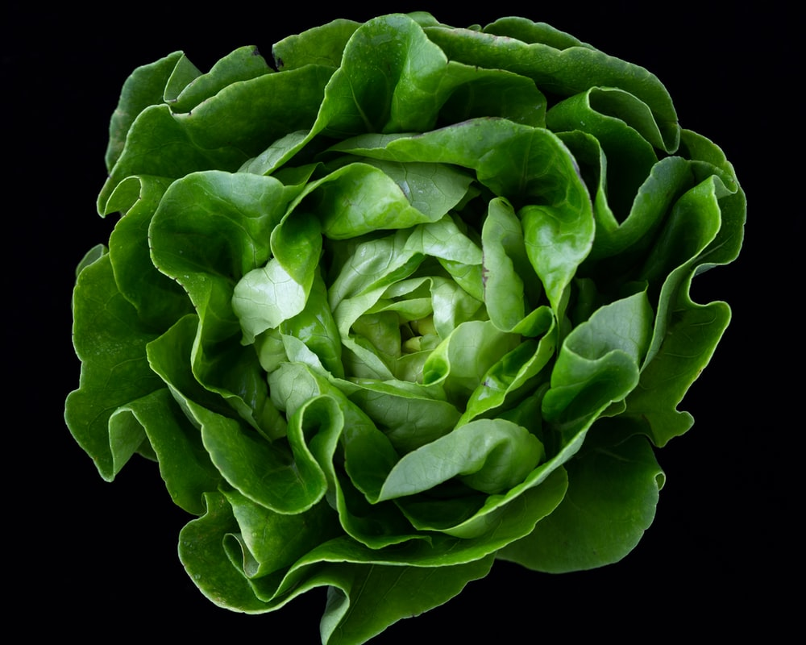

Slide 22
Eat more vegetables with lots of water in them!
Iceberg Lettuce
Cucumber
Zucchini
Celery
Tomato

Slide 23
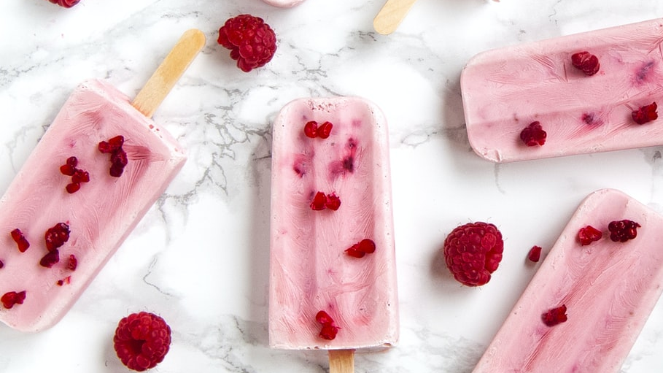

Slide 24
Popsicles!
Make pureed fruit into popsicles!
Find fun moulds to use.
Decorate your popsicles before freezing them.

