Slide 1
TIME FOR BED
Relaxation stretches that can be completed for bedtime

Slide 2
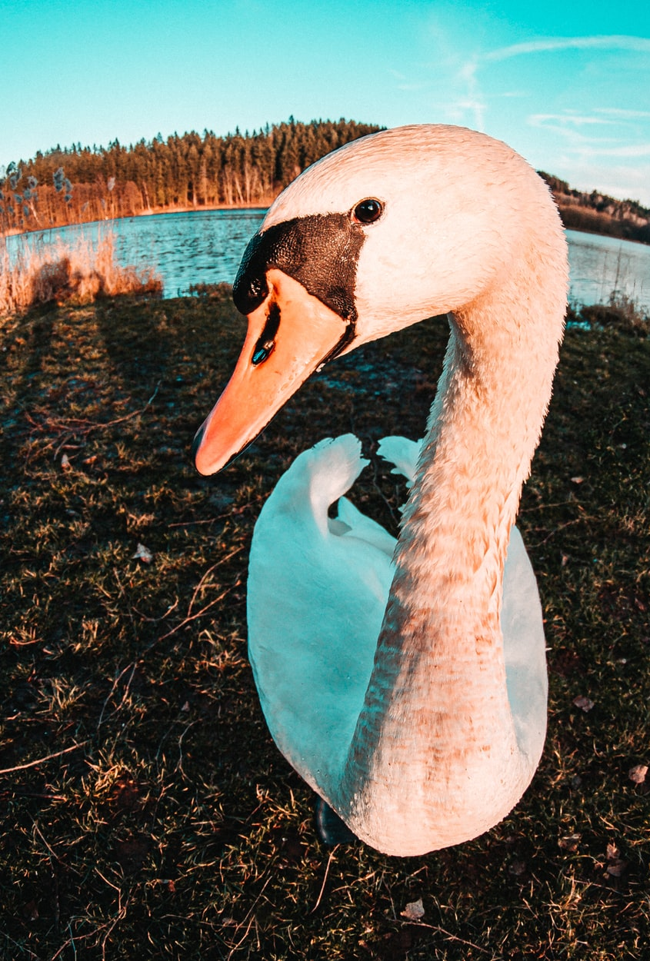
LITTLE GOOSE
Lay on your back with your feet up against a wall and legs straight. Spread your arms on the floor, like you have 2 wings.

Slide 3
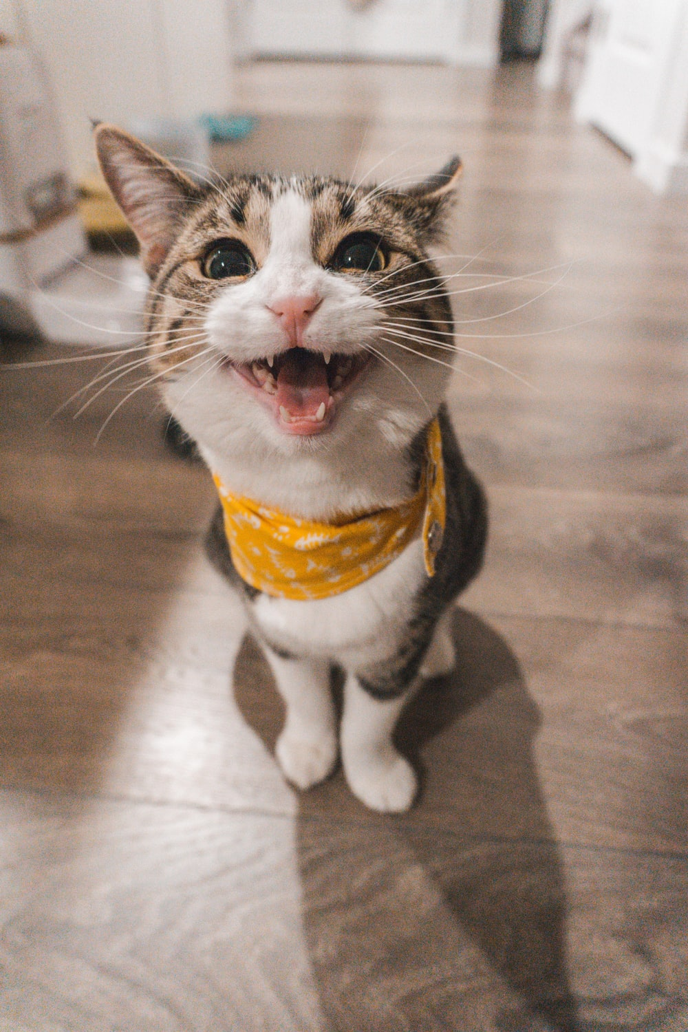
LITTLE CAT
Sit cross-legged on the floor. Bend forward at the hips and place your forehead on the floor.

Slide 4
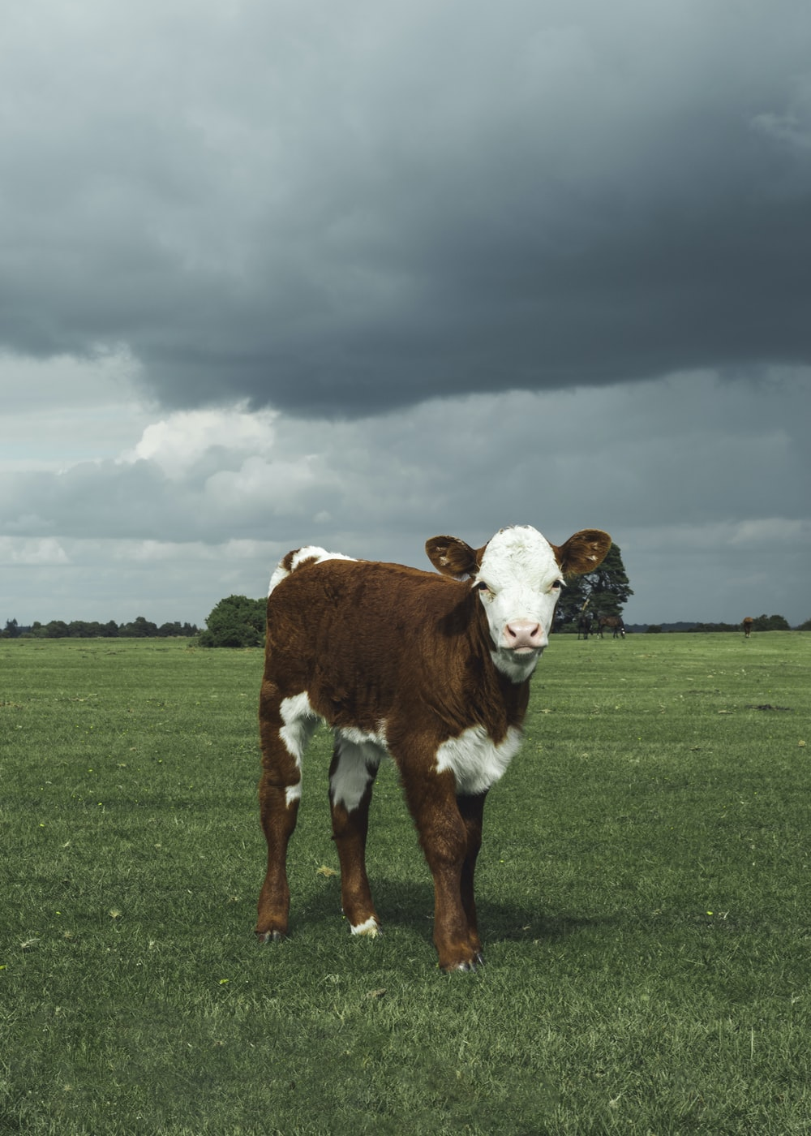
LITTLE COW
Clasp your hands together behind your back. Bend forward at the hips and hold you arms – still joined – in the air.

Slide 5
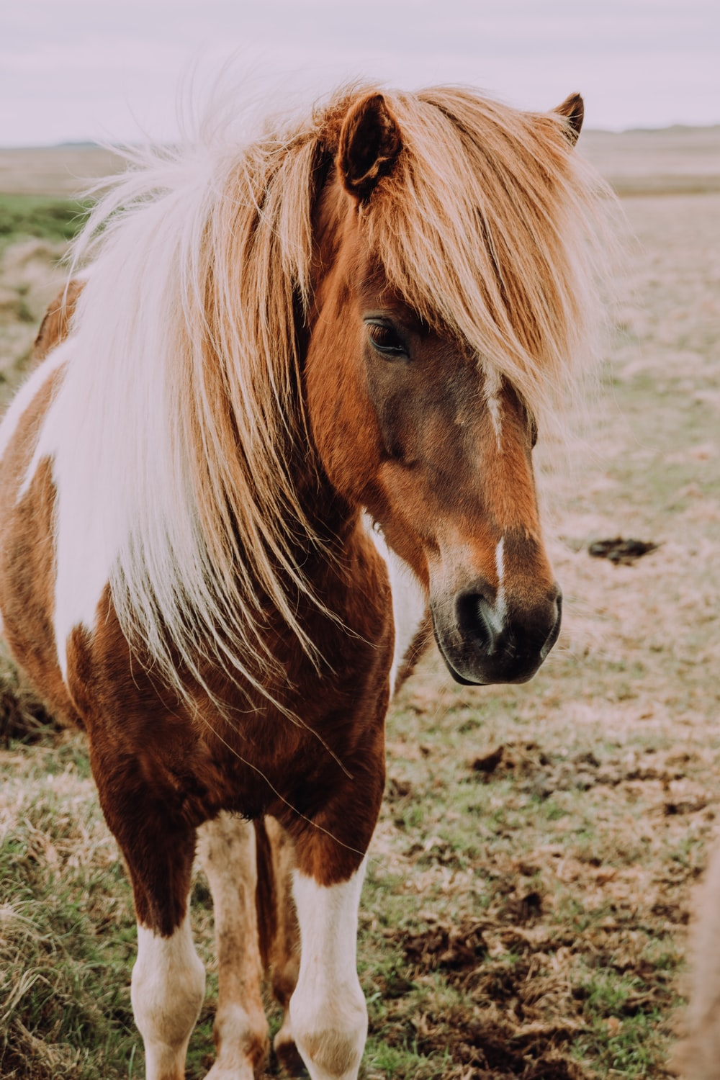
LITTLE HORSE
Lay on your back on the floor. Pull your knees to your chest and hold. You can rock side to side if this feels good.

Slide 6
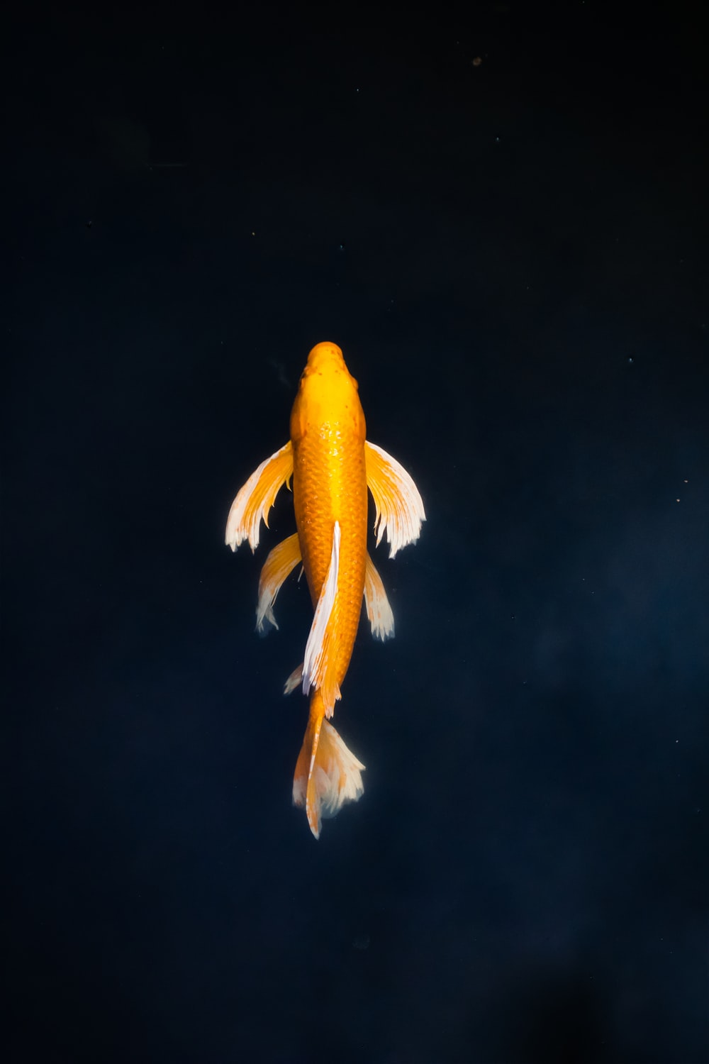
LITTLE FISH
Take a deep breath. Puff up your cheeks and hold your breath. Slowly release this breath.

Slide 7
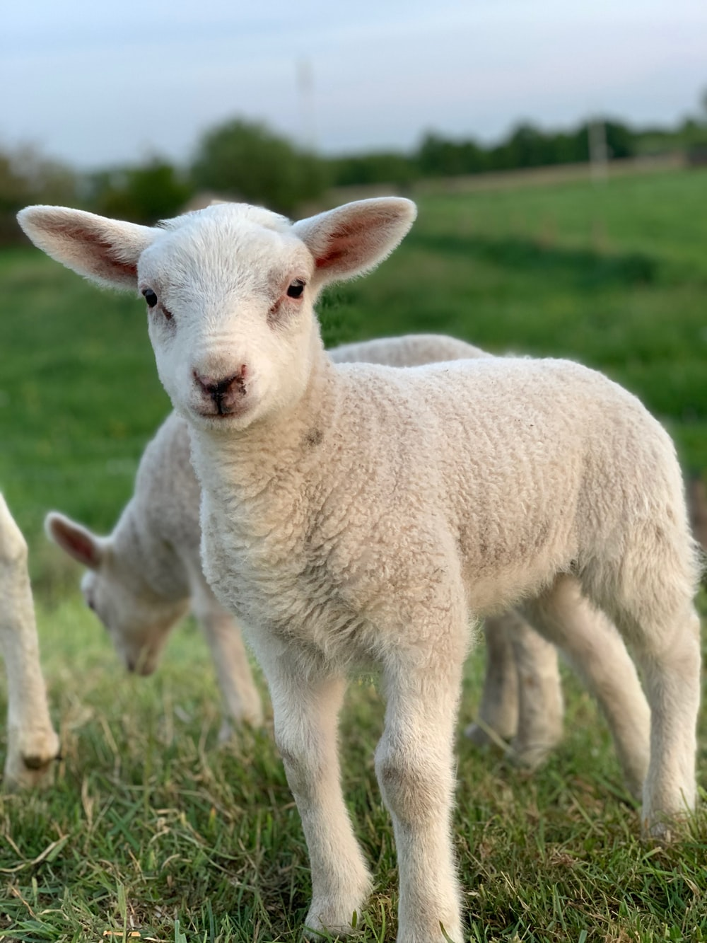
LITTLE SHEEP
Stand near a wall. Place both hands on the wall, at shoulder height. Bend your elbows slightly and push in and out against the wall.

Slide 8
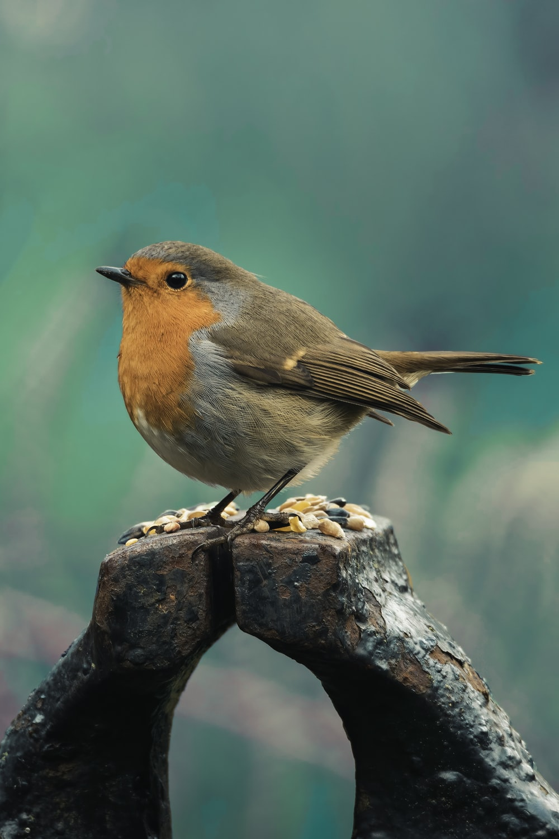
LITTLE BIRD
Close your eyes and take deep breaths. Breathe in through your nose and out through your mouth.

Slide 9
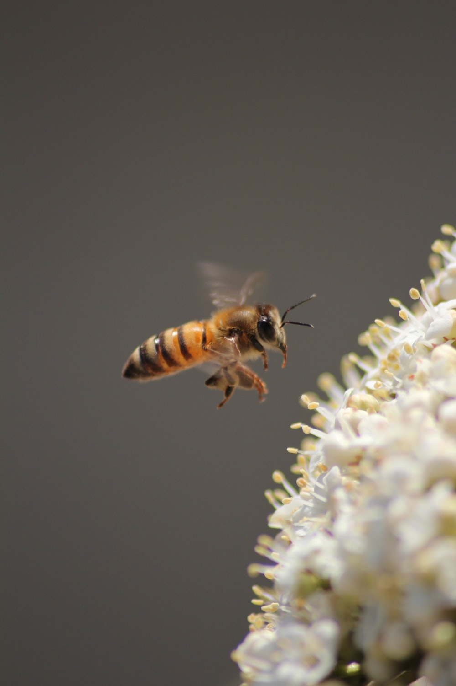
LITTLE BEE
Stand with your feet slightly apart. Bend forward at the hips. Swing your arms in figure 8 motions, either one at a time or at the same time.

Slide 10
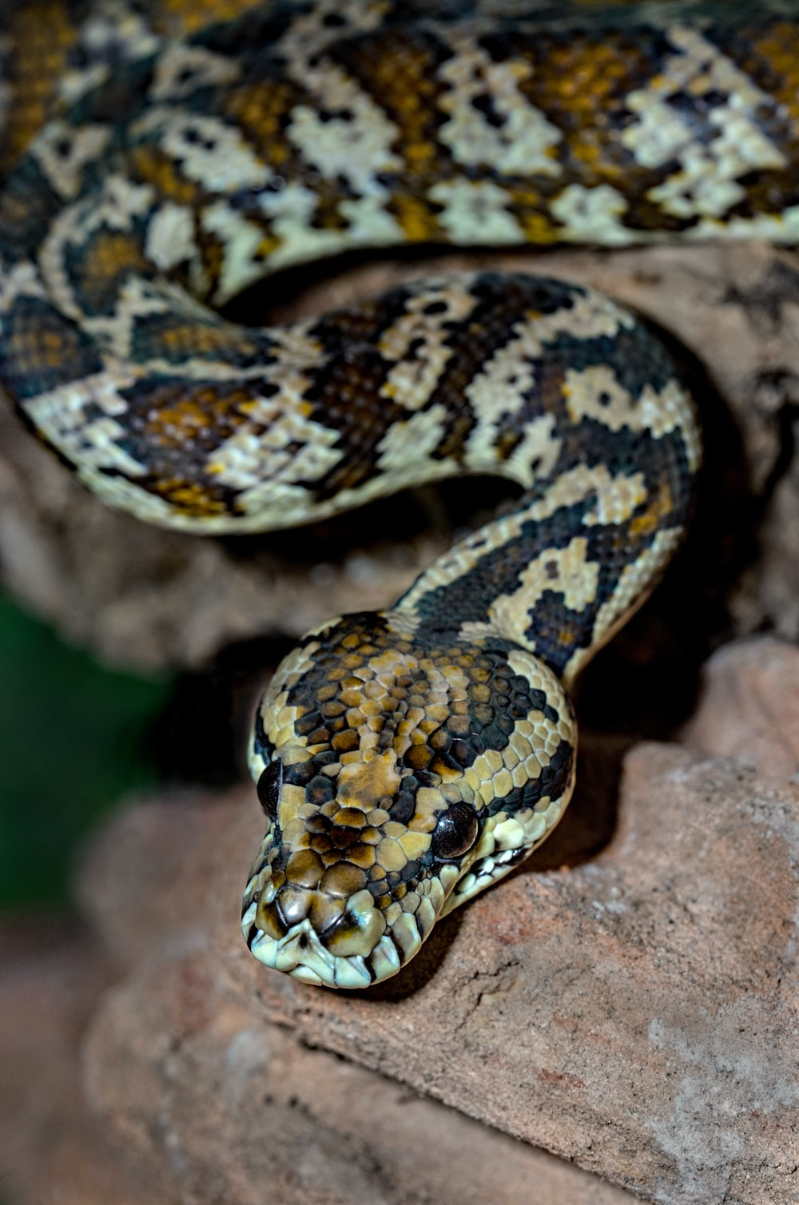
LITTLE SNAKE
Lie on your back with your legs straight and crossed at the ankles. Raise your arms over your head and cross them at the wrists.

Slide 11
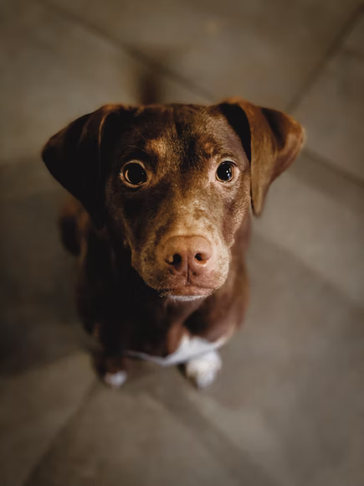
LITTLE DOG
Stand with your feet shoulder width distance apart. Bend forward at the hips and place your hands on the ground, also shoulder width distance apart.

Slide 12
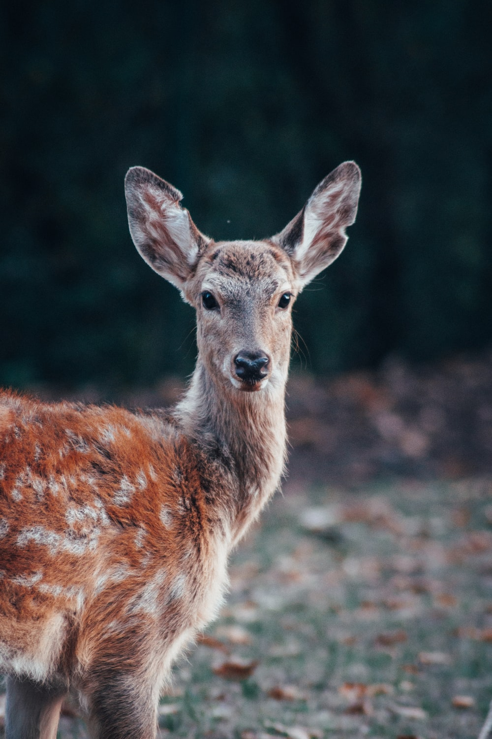
LITTLE DEER
Sit on the floor with your feet spread far apart. Bend forward at the hips and touch one foot and then the other.

