Slide 3
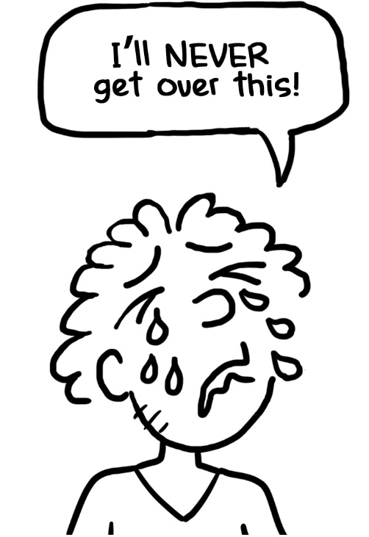

Slide 4
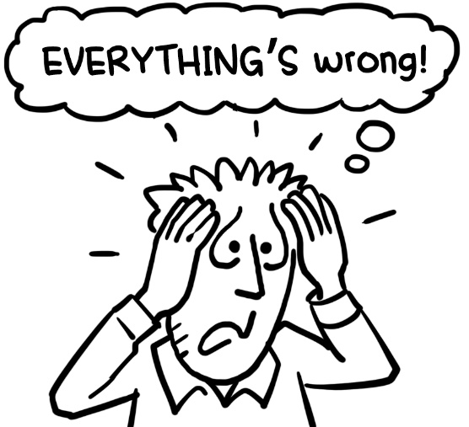
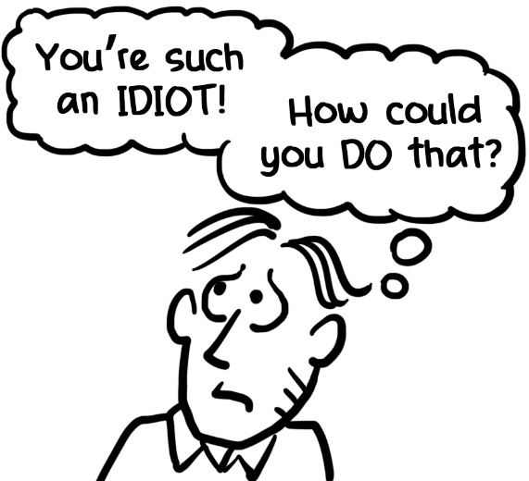
WHAT ANXIOUS PEOPLE DO
THAT KEEPS THEM ANXIOUS
They think in EXTREMES
They have fierce
INNER CRITICS

Slide 5
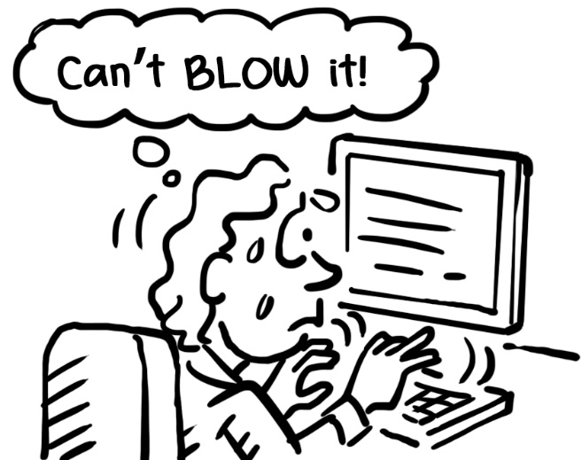
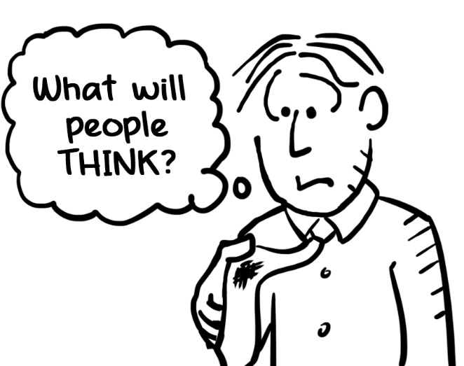
They are fearful of
MAKING MISTAKES
They worry about
how they are
PERCEIVED by
OTHERS

Slide 6
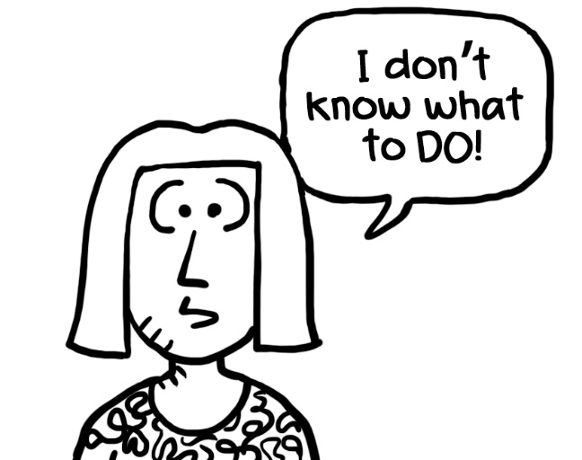
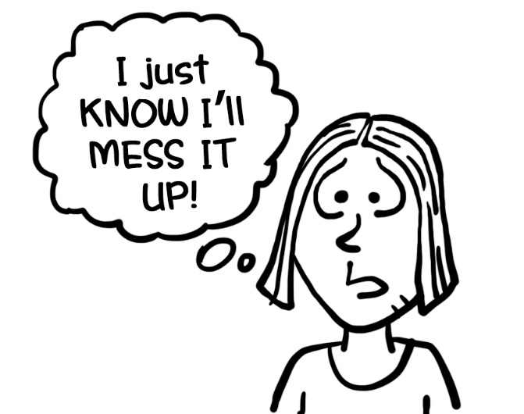
They are
easily
OVERWHELMED
They don’t
TRUST
themselves

Slide 7
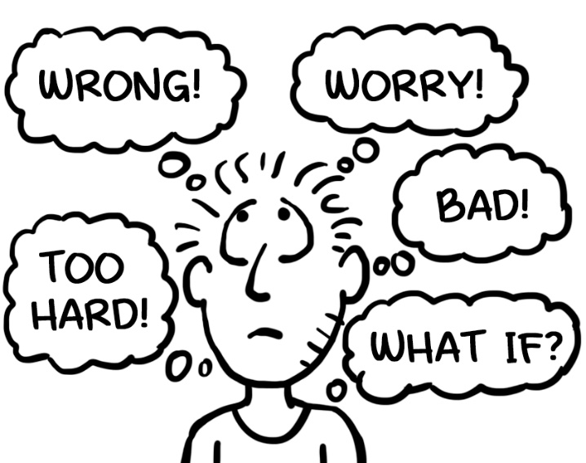
They have an
UNHELPFUL
THINKING STYLE
Their worries
are mostly
FUTURE-BASED

Slide 8
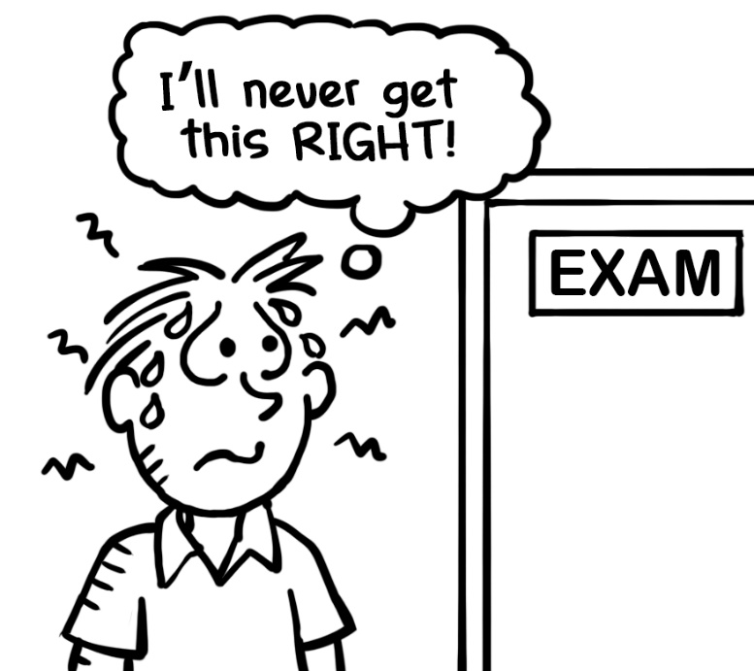
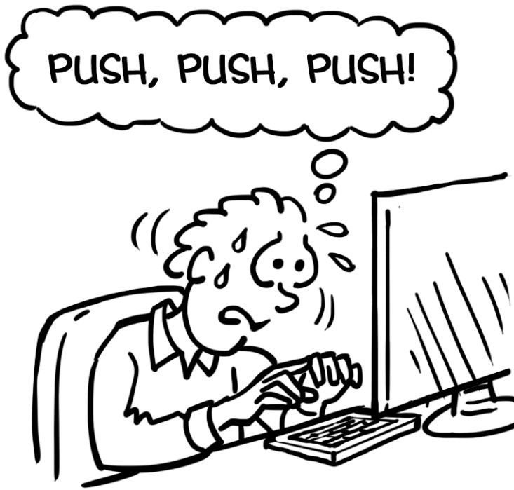
They lean to
PERFECTIONISM
and are often
HIGH
ACHIEVERS

Slide 9
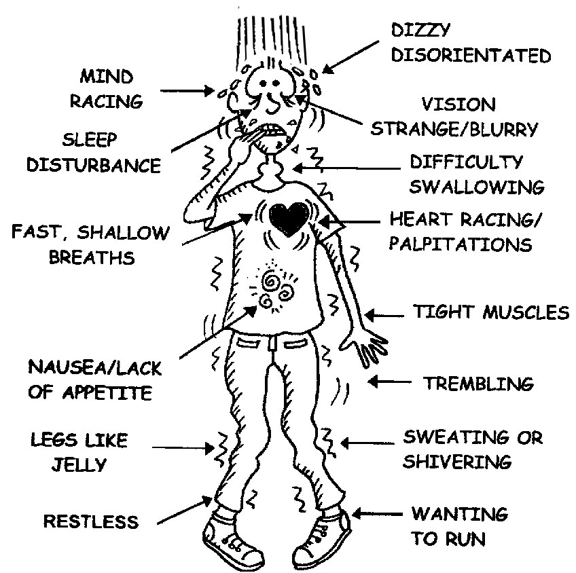
ANXIETY SYMPTOMS

Slide 10
WHY ANXIETY SYMPTOMS OCCUR
RAPID HEARTBEAT AND BREATHING:
Heartbeat and respiration rates increase to ensure that the body has sufficient ENERGY and OXYGEN it needs to either run or fight in response to the danger.

Slide 11
PALE OR FLUSHED SKIN:
As blood flow increases to the MUSCLES, BRAIN, LEGS, and ARMS, the face may alternate between appearing pale as blood moves away to the limbs or flushed as blood rushes back to the head and brain.

Slide 12
DILATED PUPILS:
Dilation of the pupils allows more light into the eyes and results in BETTER VISION of the surroundings. This allows in more VISUAL INFORMATION to process the best action for self-preservation.

Slide 13
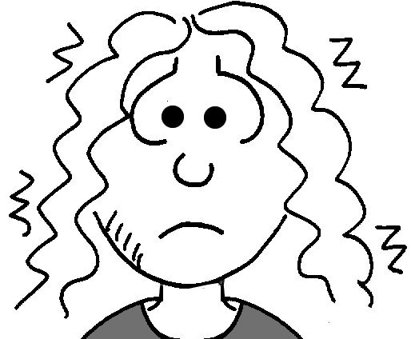
TREMBLING:
MUSCLES become tense so as to be primed for action. This tension can result in TREMBLING or SHAKING.

Slide 14
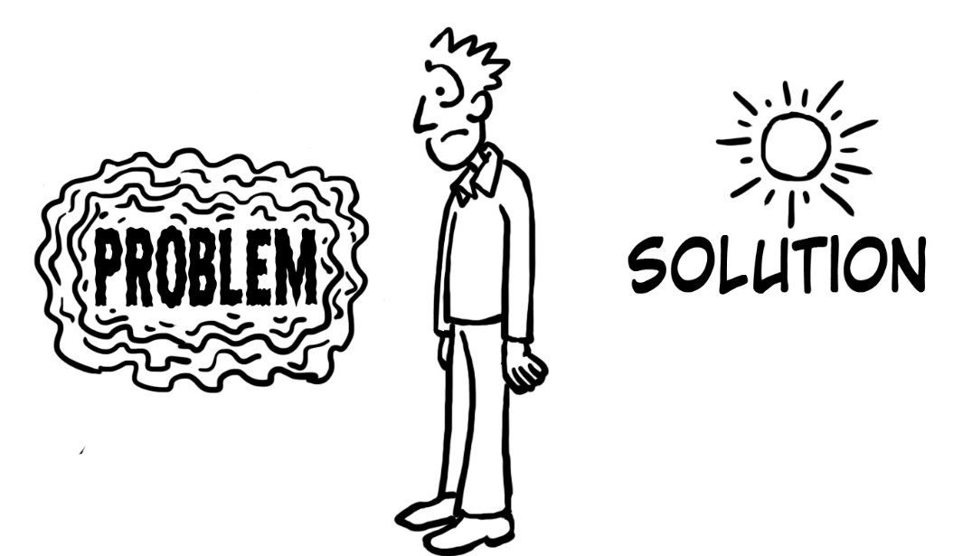
GETTING STUCK ON ANXIETY

Slide 15
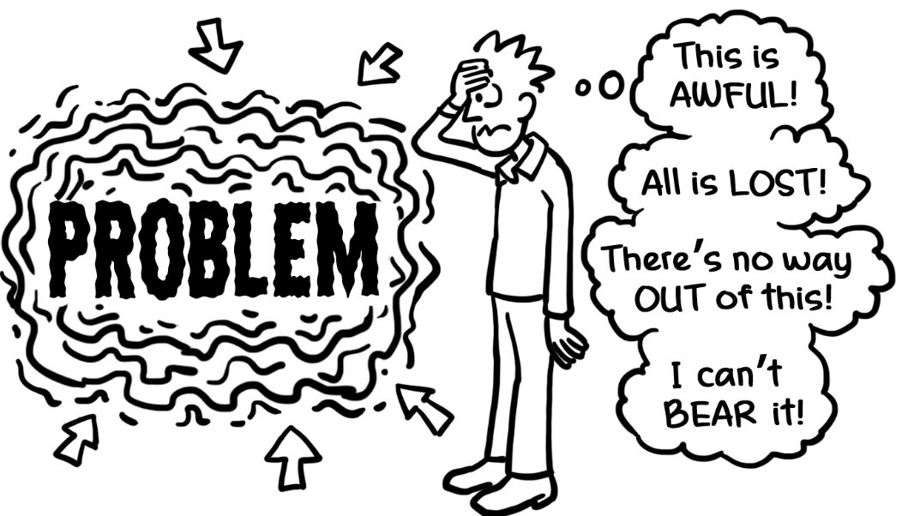

Slide 16
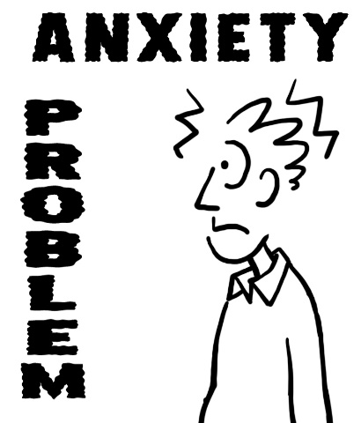
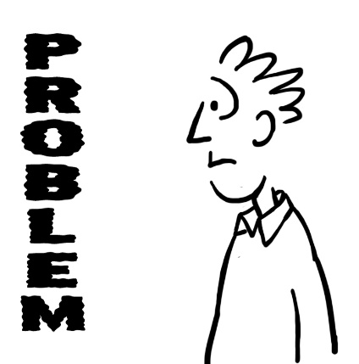
You have a PROBLEM. You feel ANXIOUS
about the problem
Instead of dealing with …you stay FIXATED on
the PROBLEM… the ANXIETY…

Slide 17
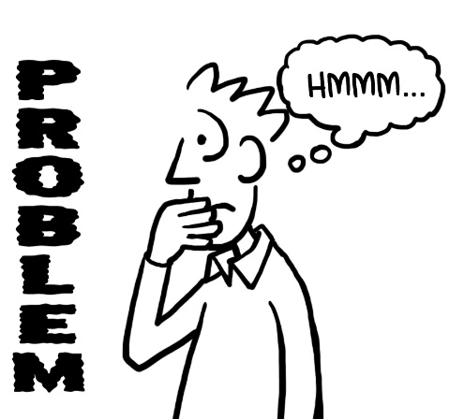
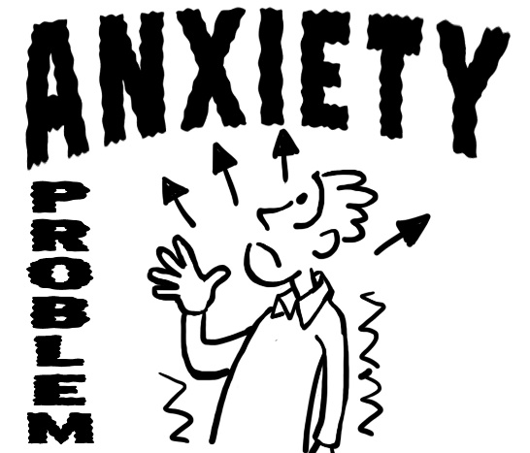
… which then becomes THE problem!

Slide 18
THE COST OF FEAR
Lets’ look at those ANXIETY SYMPTOMS again
FEAR

Slide 19
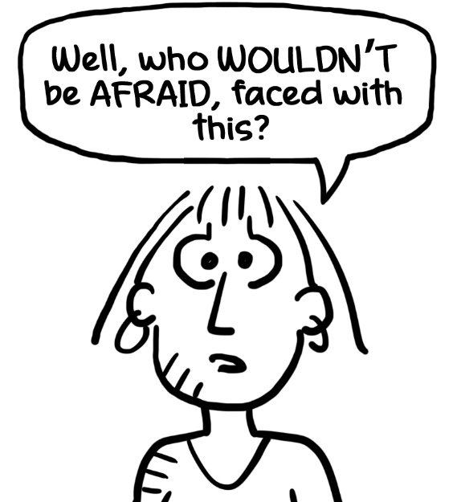
UNHEALTHY FEAR
CATASTROPHISING
EXCESSIVE WORRYING
FEARFUL PROJECTIONS
SELF-SABOTAGING BEHAVIOURS
SELF-CRITICISM
WHAT FEAR DOES:
Gives you TUNNEL VISION. You look for and see,
evidence of ONLY what you fear
FEAR releases STRESS HORMONES which lower
your IMMUNITY
It FEEDS on ITSELF – the more you FEAR, the more
you FIND to fear
It causes you to miss seeing OPPORTUNITIES.
You will see (and find) only what you EXPECT to see
It kills any EXISTING joy, hope and good that there is in the PRESENT

Slide 20
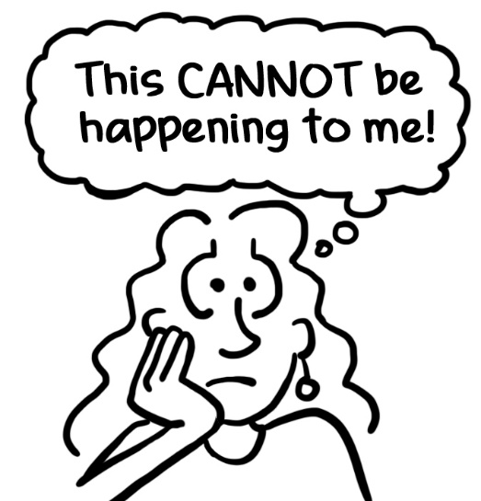
THE FIVE STAGES OF GRIEF
DENIAL
SHOCK
NUMBNESS
INABILITY TO TAKE THINGS IN
FEELING OF UNREALITY

Slide 21
ANGER
WANTING TO FIND A SOURCE OF BLAME
WANTING TO LASH OUT/LASHING OUT
IRRITABLE

Slide 22
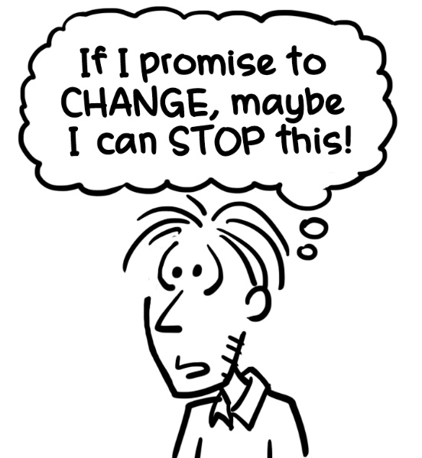
BARGAINING
WANTING TO NEGATE WHAT IS HAPPENING
MAKING A ‘TRADE’ TO GET BACK WHAT MAY BE OR WAS LOST
MAGICAL THINKING

Slide 23
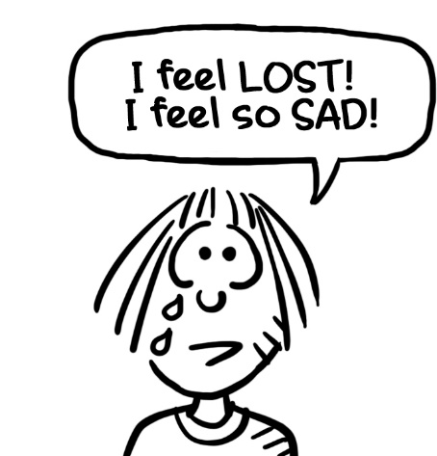
DEPRESSION
DEEPER FEELINGS NOW SURFACE
EXTENT OF LOSS NOW REALISED
REALITY NOW ACKNOWLEDGED

Slide 24
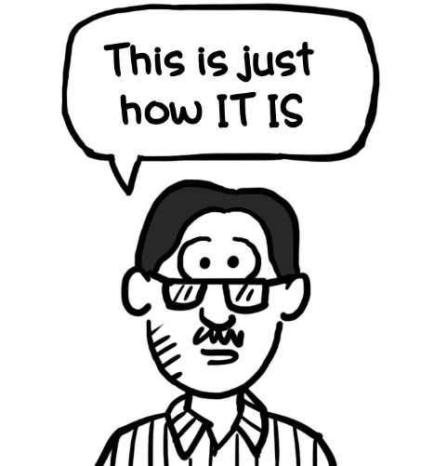
ACCEPTANCE
ADJUSTMENT TO LIFE AS IT NOW IS
EMBRACING CHANGE
RELEASING RESISTANCE
CREATING A NEW ‘NORMAL’

Slide 25
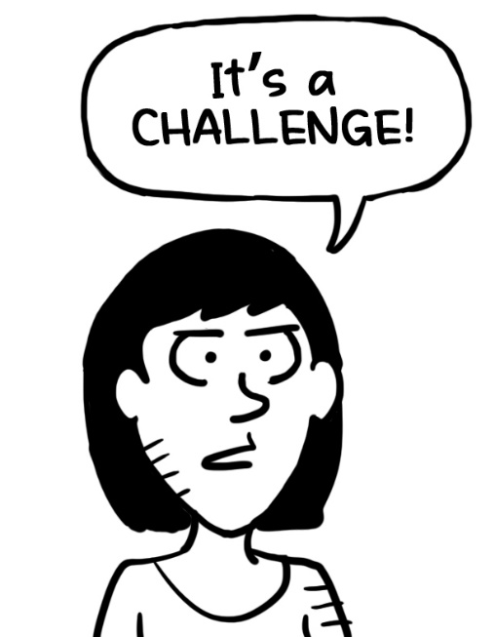
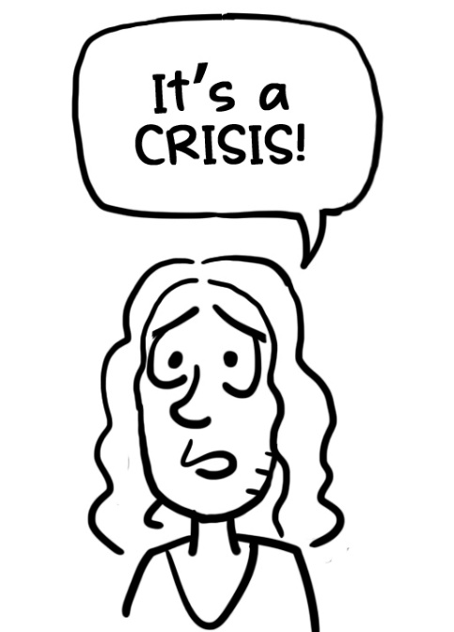
WAYS OF SEEING BIG CHANGES

Slide 26
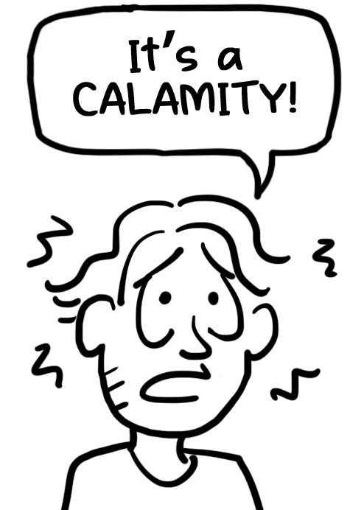

Slide 27
TO BE WORKED THROUGH
A PROBLEM THAT HAS A SOLUTION
HAS A BEGINNING A MIDDLE AND AN END
CHARACTER-BUILDING

Slide 28
A CHALLENGE BUT WITH A GREATER EMOTIONAL ‘CHARGE’
SITUATION FEELS MORE DIFFICULT TO MANAGE
HOWEVER, A PASSING PHASE. POSSIBLE BENEFITS AT OUTCOME

Slide 29
CONCEPT OF ‘RUIN’
LASTING OR PERMANENT EMOTIONAL IMPACT
COMPLETELY NEGATIVE ‘SOUL-DESTROYING’ EVENT

Slide 30
CAN’T CONTROL CAN CONTROL
WHAT OTHERS THINK
WHAT OTHERS DO
HOW LONG THIS GOES FOR
THE PAST
WHAT HAS HAPPENED
WHETHER I SCARE MYSELF OR NOT
HOW MUCH I FOCUS ON THE NEGATIVE
HOW MUCH I STAY IN THE PRESENT
MY THINKING

Slide 31
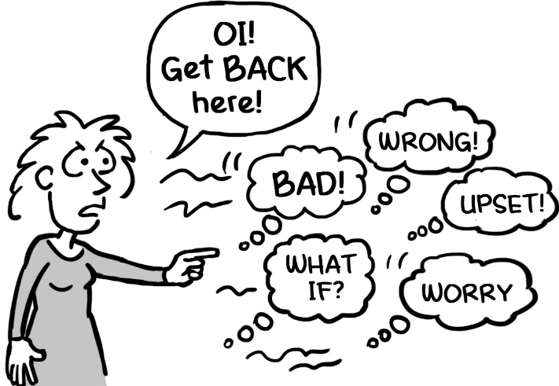
‘HERDING CATS’
What you THINK ABOUT is a CHOICE
What you think about affects how you FEEL
How LONG you stay focussed on something is a CHOICE
Life just HAPPENS. Things just ARE. It’s what you TELL yourself about what’s happening that governs how it affects you
Only YOU can help YOU feel better!

Slide 32
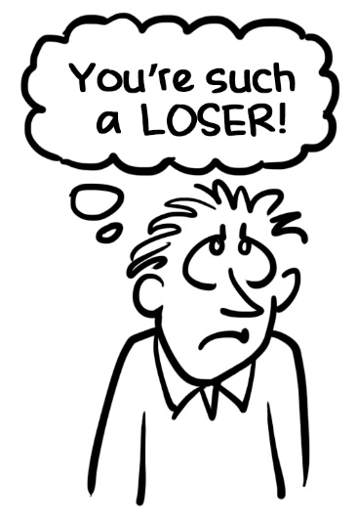
RELATIONSHIP WITH SELF
LOW SELF ESTEEM SELF-CRITICISM

Slide 33
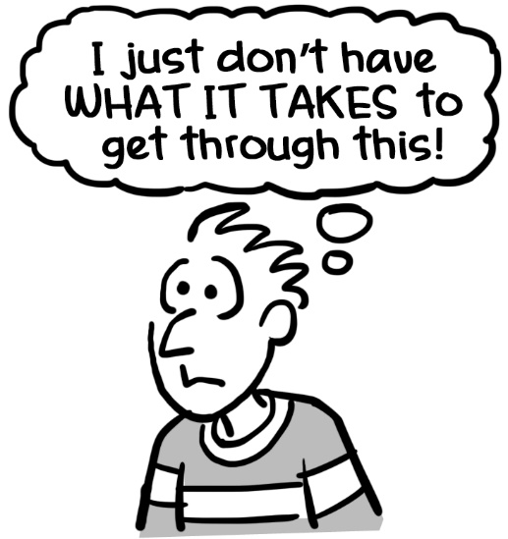
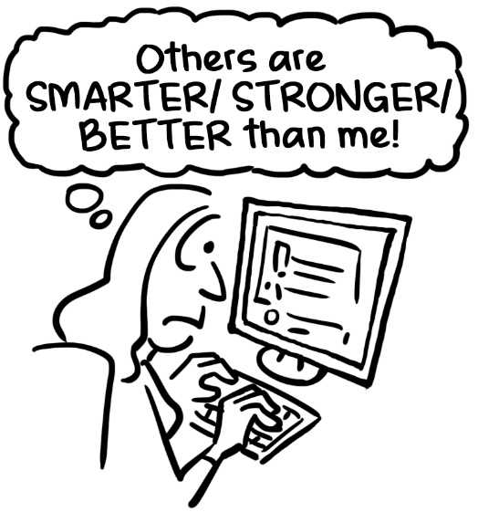
DOUBTING SELF
COMPARING SELF TO OTHERS
(unfavourably)

Slide 34
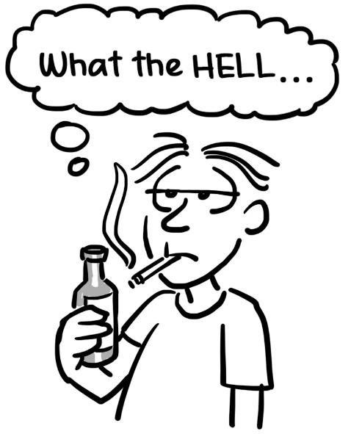
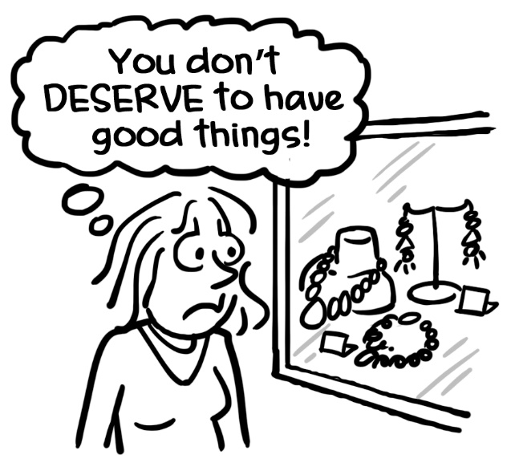
PUNISHING SELF
LACK OF SELF CARE

Slide 35
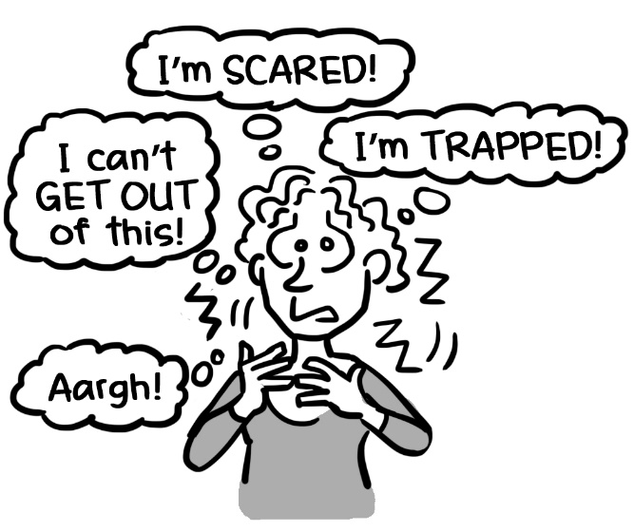
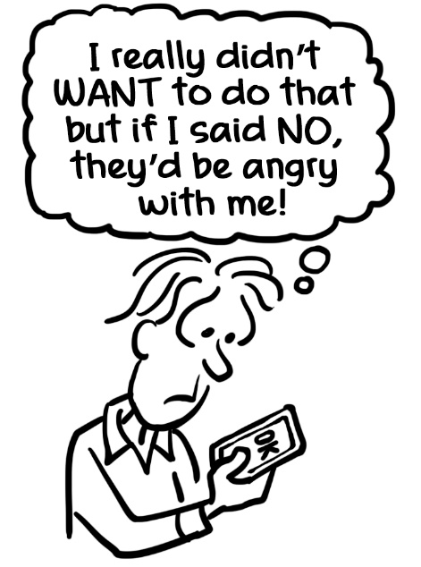
INABILITY TO SELF-SOOTHE
INABILITY TO ASSERT
And seeking APPROVAL, ACCEPTANCE and APPRECIATION of self from OUTSIDE sources.

Slide 36
LONELINESS:
feels STRESSFUL
is being alone and NOT LIKING it
brings a sense that something is MISSING
feels like a DEFICIENCY
feels IMPOSED (no choice)
SOLITUDE:
is SATISFYING
is being alone and CONTENT
means your own company is DESIRABLE
is RESTORATIVE
is a CHOICE

Slide 37
TOUCH IS A TOOL FOR:
COMMUNICATION
CONVEYING EMOTIONS
BUILDING TRUST and RAPPORT
OFFERING COMFORT
CREATING INTIMACY
REDUCING FEAR
SUPPORTING ANOTHER
EXPRESSING LOVE AND CARE
BONDING

