Slide 1




A quick introduction to
Python

Slide 2
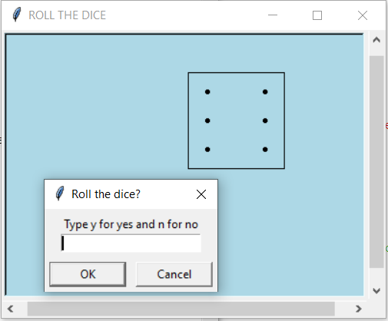
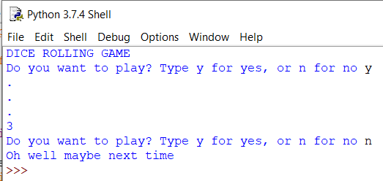

Outline for the class:
What are we going to do?
Code a simple Python script to display a random number between one and six (the base for our dice game)
Use if/else to give it some user control (Do you want to play or not?)
Adding two types of loops (e.g. to execute a set number of times or to execute until app user chooses to exit)
Making our own functions to re-use code as well as using inbuilt Python functions
Using the Turtle graphics module in Python and earlier basic coding skills to make a more recognisable dice (Outputting to a windows screen and not the command line)

Slide 3
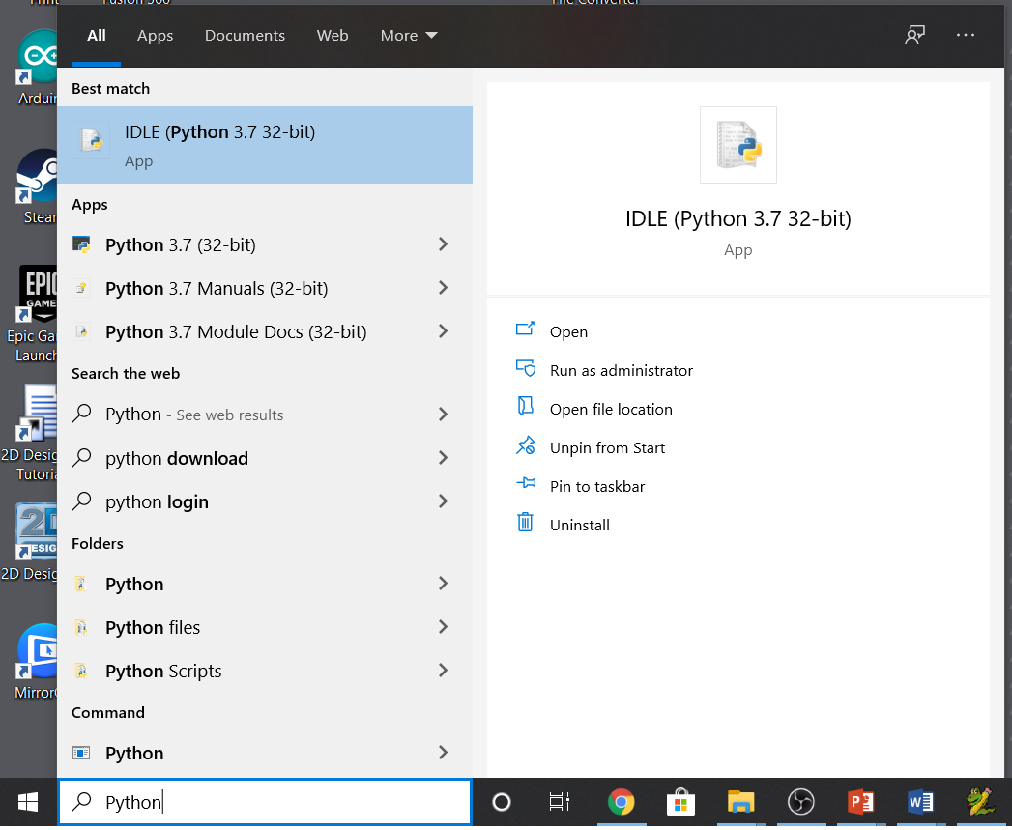
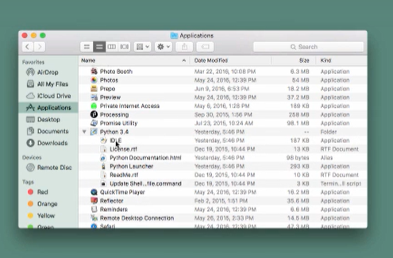
What will you need(Check if you have Python 3?)
If you have a Windows PC or a MAC check to see if your machine has Python 3.
In windows search type ‘Python’ and see if you have the IDLE app (which is the Python editor). If not see next slide to download
On a mac open up Finder/Applications and look for Python 3

Slide 4
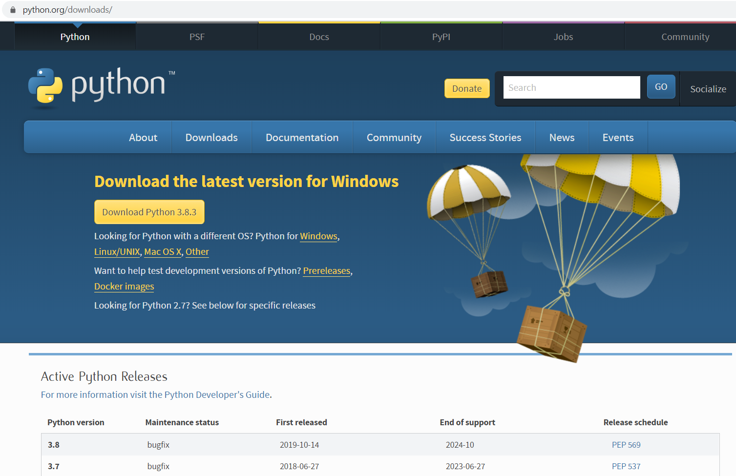
Download Python 3
If you haven’t got Python please try to download the latest version from the web page shown https://www.python.org/downloads/
Windows download
Mac OS X download

Slide 5
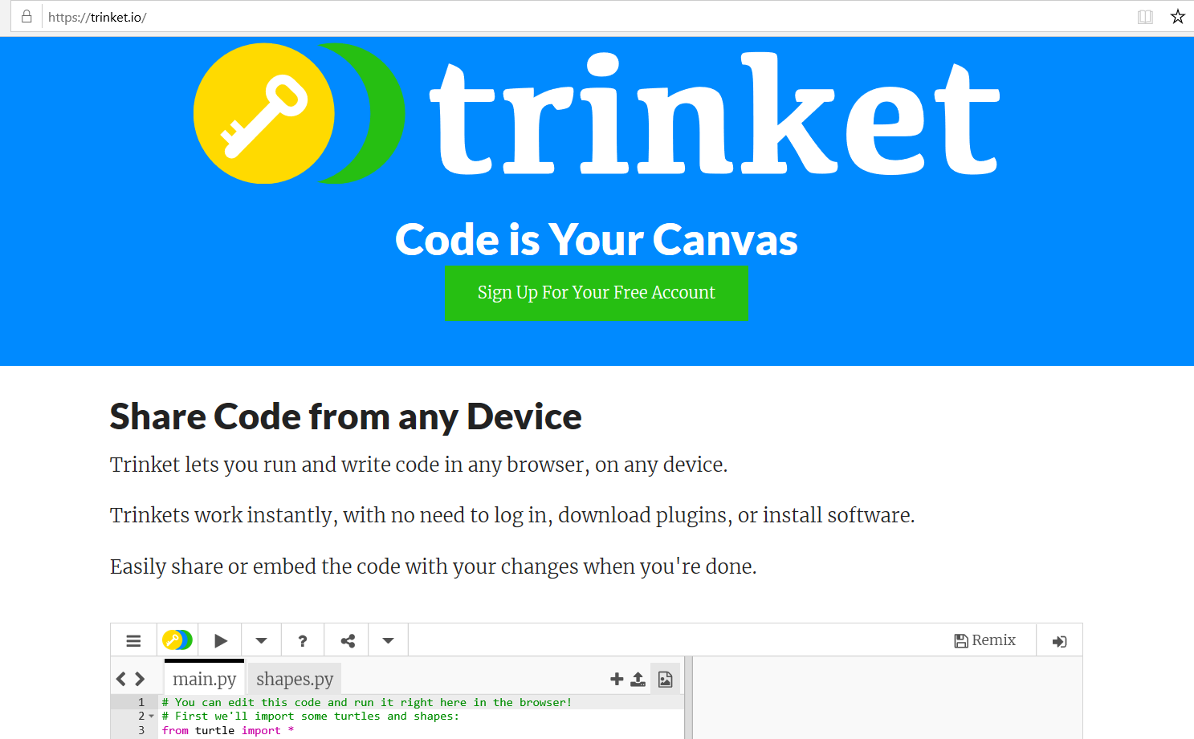
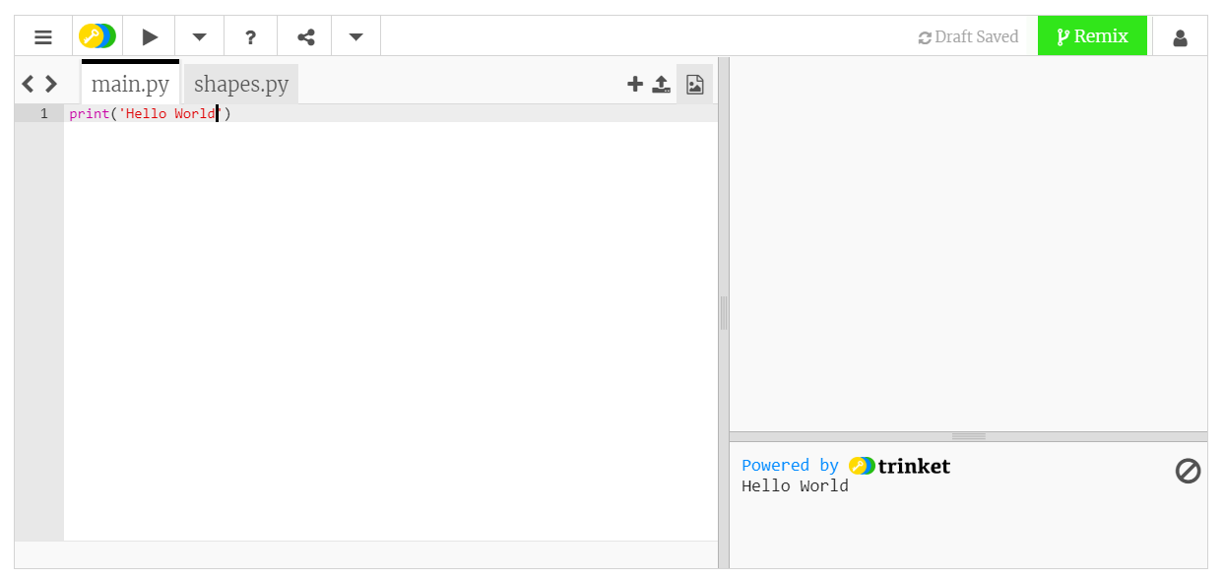
Use Trinket an online editor (if you don’t have a PC or MAC)
If you don’t have a PC or MAC and are using an iPad or Android tablet you will need an online Python editor such as Trinket, which is at the following website https://trinket.io/
You can create your own account or even just delete existing code in the editor and then type your own code and run it. More on this later…

Slide 6
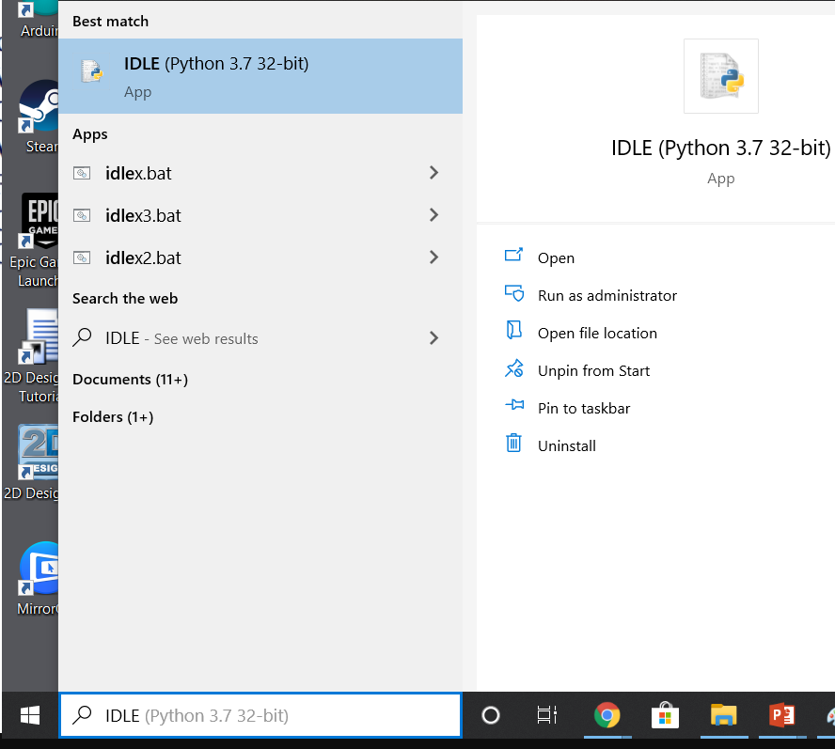
Opening IDLE
To open IDLE type it into your START (Search menu) and if it is installed you will see it. Click it and IDLE will open

Slide 7
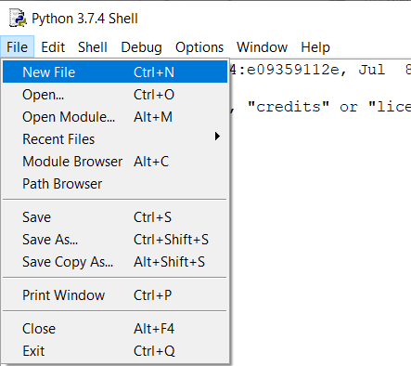
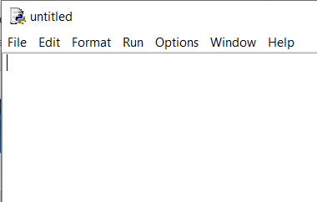
Opening a python script from interactive (shell) mode of IDLE
From the file menu choose ‘New File’

Slide 8
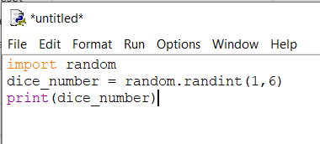
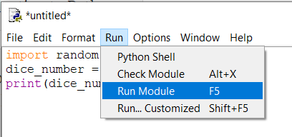
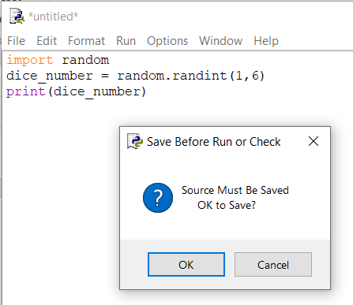
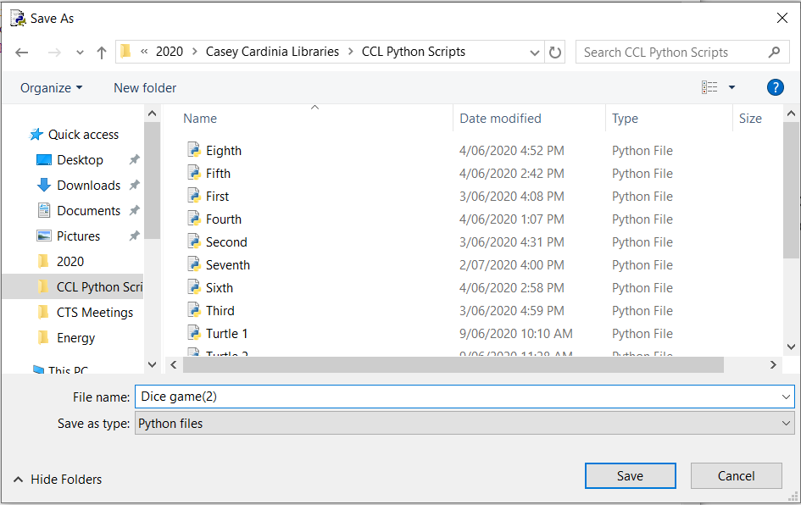
Writing our first script, saving and running
Write the code above and then save it and run it from the Run menu as shown
When prompted to save, save in folder location of your choice

Slide 9
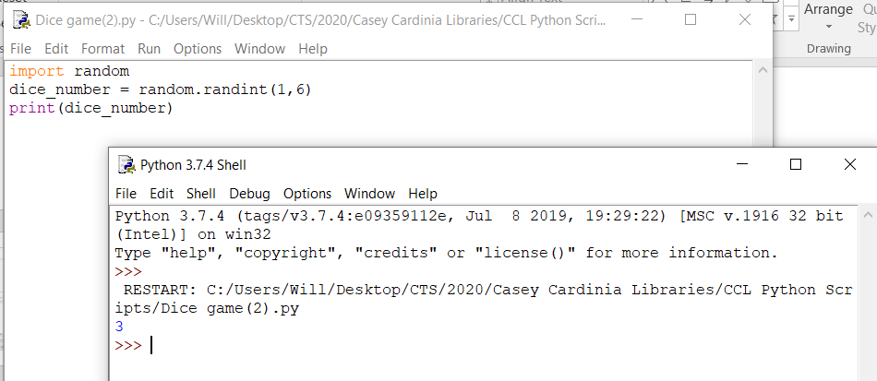
The result from running our first script
Note to run again we must use the ‘Run’ menu from the editor (not shell)
It will open up the interactive mode (shell) and output the result
Once the script has run and printed output it finishes which is shown in the shell as >>>
In this case it has randomly generated a number between 1 and 6 which is 3

Slide 10
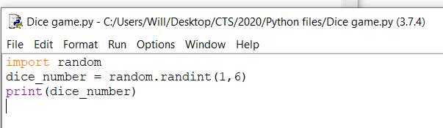
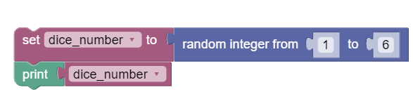
Examining the Python script
Similar code in Blocky format
Important aspects
We can import modules that other’s have written
We set variables which are memory locations in which to save data which can change. The data type in this case is an integer (whole number) known as int for short
We call functions that perform a little job using code (e.g print() function. Sometimes we send the function some data to deal with. This sent data is known as an argument.
A function which is part of a module is called a method e.g random.randint(1,6)
What is lacking in this program? → any user control apart from re-running the program

Slide 11
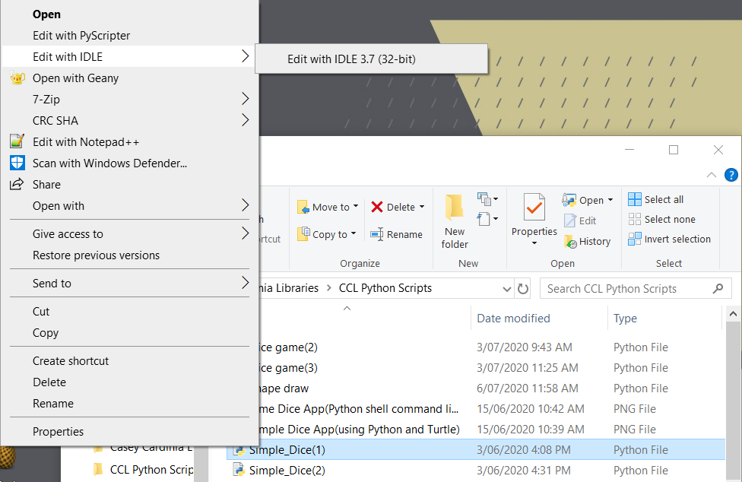
Opening a script you have written in idle
If you close IDLE by mistake and want to keep editing the script you can either open IDLE from the start menu again or go to the folder where you saved your scripts.
Right click on the file and choose ‘Edit with IDLE’ as shown and it will open your scipt.

Slide 12
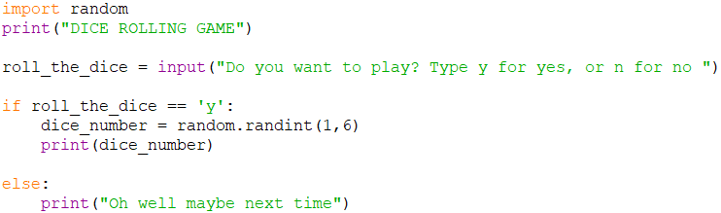
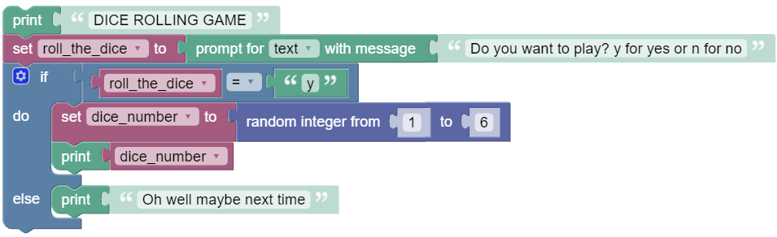
Adding some control (if/else conditionals)
Similar code in Blocky format
Uses input function to get some input from user (We have used data type string (text) to ask user for input. Strings (str) need to be encompasses by ‘ ‘ or “ “
Uses user’s input to make a decision (if/else statements (conditionals) and comparison operators == != > etc). Note that == is different to =
Colon : is used after if/else statement and code after must be indented.
Deficiencies
If you type anything else it will still go to else, also if you type a capital Y it will still go to else
Program still closes afterwards → can we control when the program finishes? (exit)

Slide 13
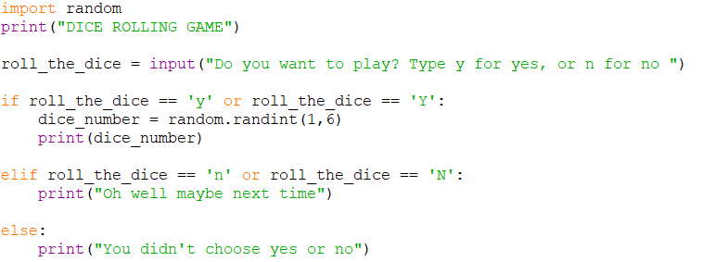
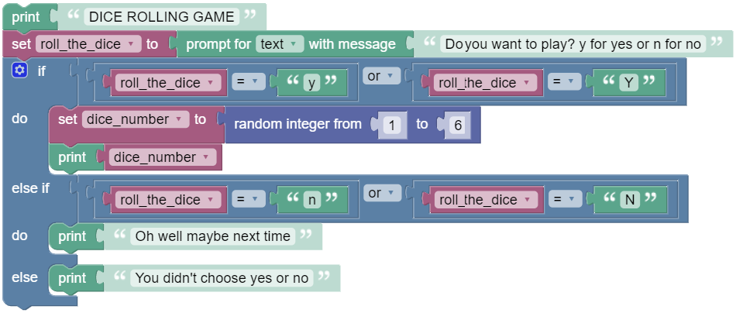
Adding OR comparison operators
Improved with OR comparison operators added to account for y or Y etc
And elif to add more decision options
Similar code in Blocky format

Slide 14
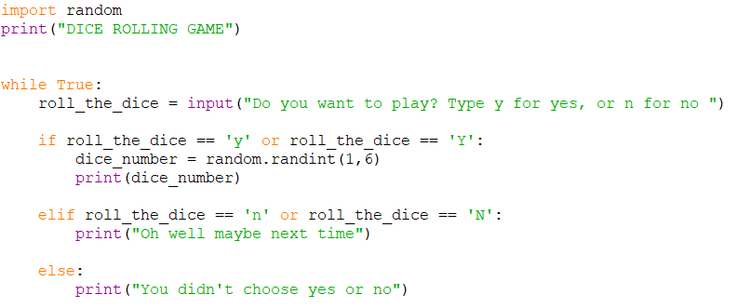
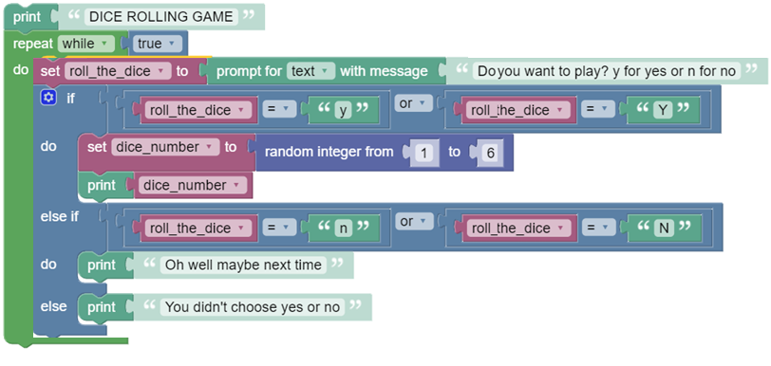
Adding a loop (To keep the script going)
This code is better but what is still wrong? → Never ending loop. We need a structure to exit the loop to end the program.
Note again that code belonging to While True must be indented after the colon
Similar code in Blocky format

Slide 15
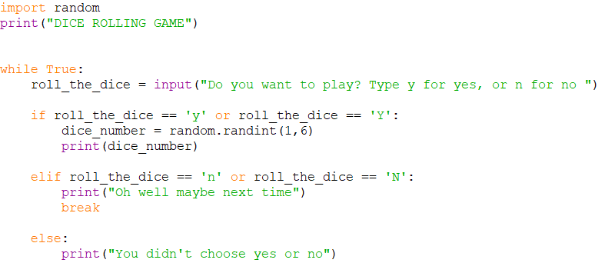
Adding a break out from the loop
The break statement breaks straight out of the while True loop and as there is no code at the bottom the script ends

Slide 16
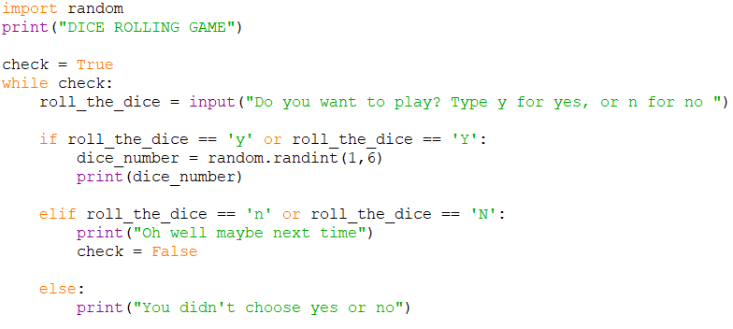
Adding a break out from the loop (another way)
Rather than a ‘break’ ending the loop straight away, after the user types ‘n’ for no the program goes back to the top of the loop at ‘While check:’ but then exits as check now equals false

Slide 17
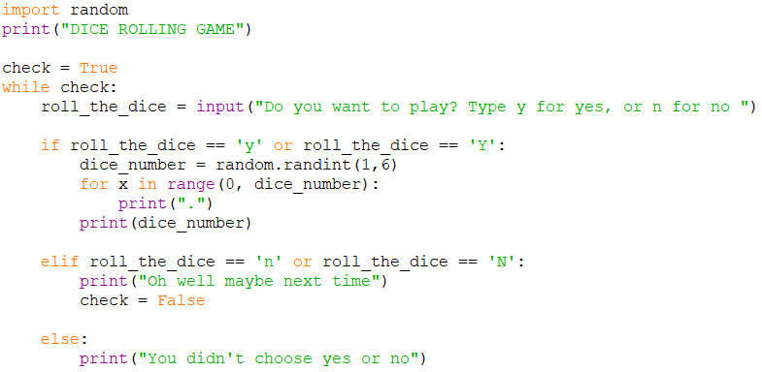
Using a ‘For’ loop to add simple dice dots
For loop also have a colon : meaning the connected code is indented. Notice too that statement function print(dice_number) is not indented as we want it to execute once after the for loop has run a number of times.

Slide 18
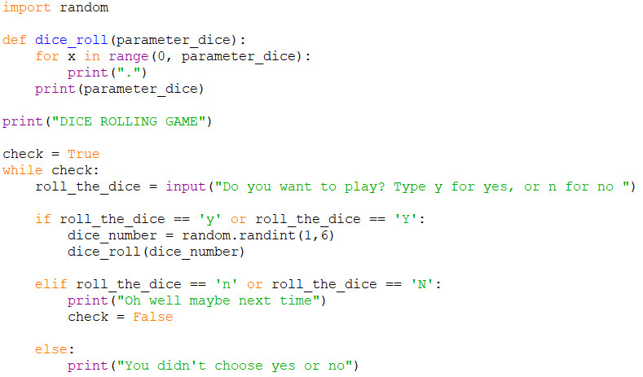
Making our own functions (streamlining code)
Making your own functions is a great way to streamline and make re-useable code
Functions must be defined above the code calling it.
The argument data passed is then saved as a parameter (which is a variable in the function itself). Note it has a different variable name to the variable back in code calling the function
We call the function and pass the data value in variable dice_number as an argument

Slide 19
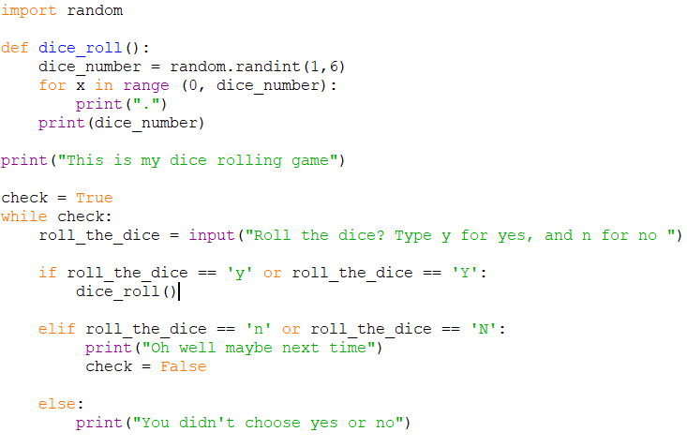
Making our own functions (streamlining code)
This is alternative code but the function call does not pass data in arguments.

Slide 20
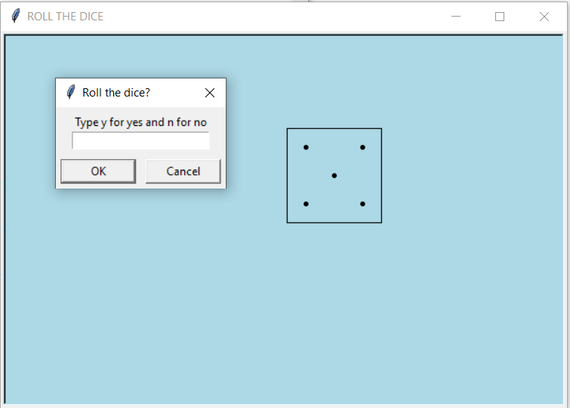
Importing turtle graphics module to draw a dice
Turtle graphics is a popular module which is part of Python 3. We just need it to import it like we did with importing random
Turtle graphics uses an x,y coordinate system to draw lines, shapes and dot like graphics. You may have used it with Scratch programming

Slide 21
The basic flow of our new code
Import modules random and turtle
Create objects ‘square’ (for drawing dice square), ‘window’(for setting up how screen looks) and ‘dot_drawer’(for drawing the dice dots)
Use methods(functions) attached to these new objects to set up window title, background colour, window size, dot_drawer shape etc
Use variables to save grid (x,y) values in lists for each dice number
Make our own function to draw a basic square when called
Make our own function to draw the dice dots each time it is called from main loop
Code a main while loop, like we did previously, to prompt user whether they want to roll the dice. If they choose yes the code calls the dice_roll() function.

Slide 22
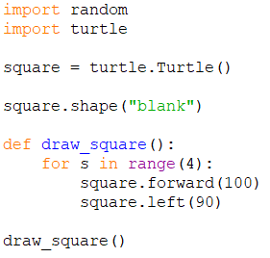
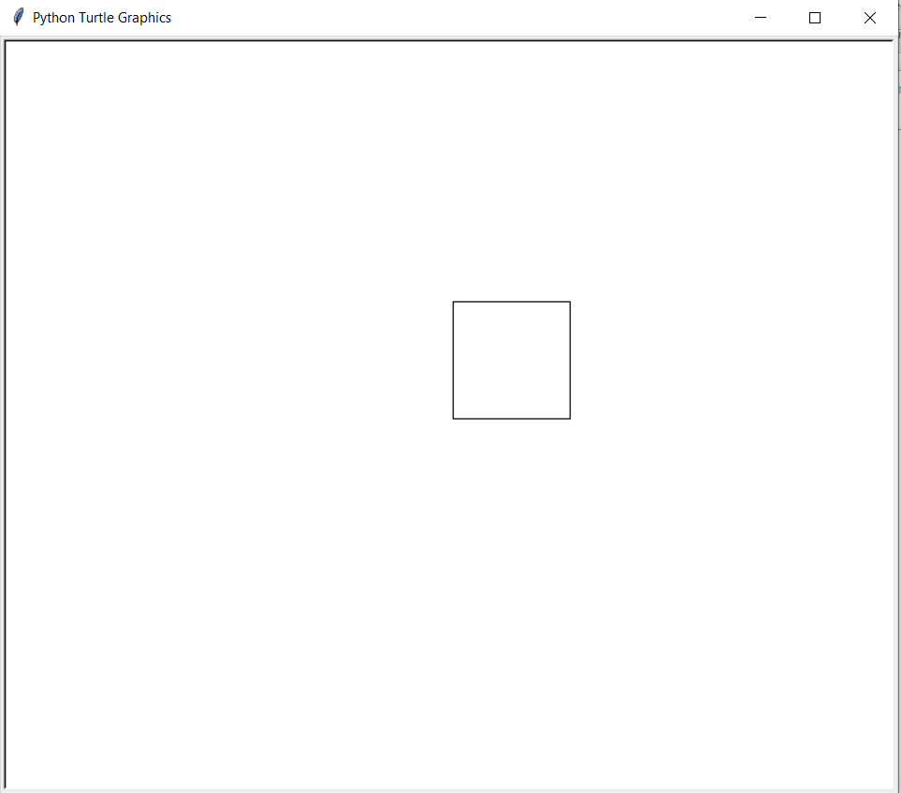
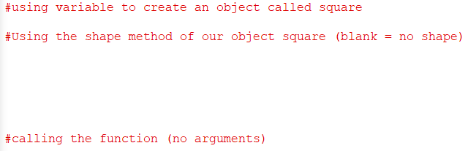
Turtle graphics (start with a square for our dice)
The code in red after # are comments that leave notes on what the code is doing. It is ignored by Python and not strictly needed
The code square = turtle.Turtle() uses a variable to save the methods of the Turtle module (this creates an object called square). Then when we use the methods they are connected to object square e.g. square forward(100) draws a square line 100 long

Slide 23
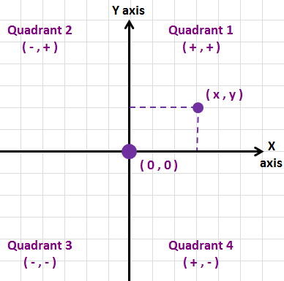
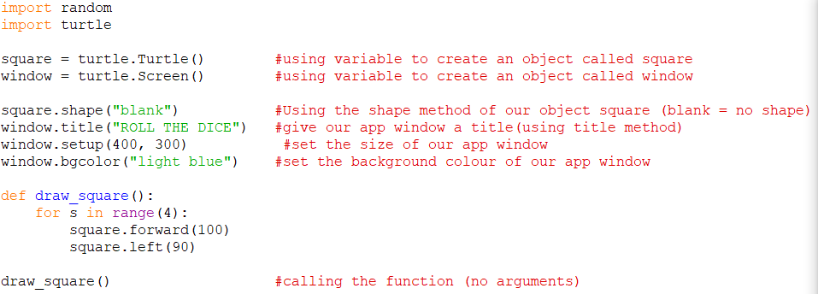
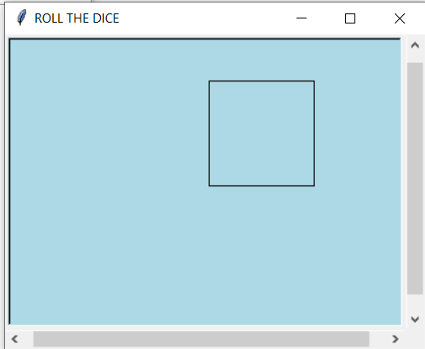
Create another object called window (or screen)
We want to customise the dice application’s screen window

Slide 24
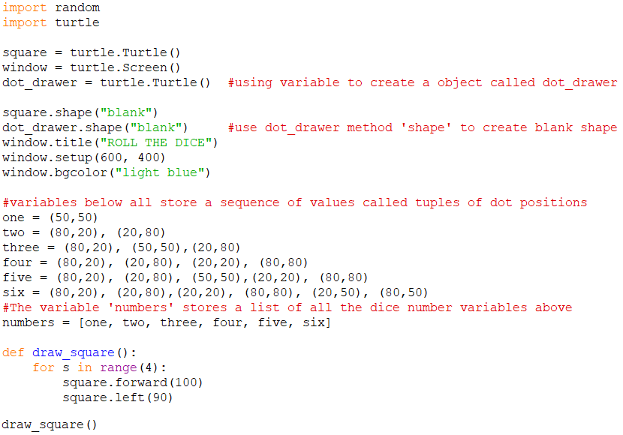
Create another object called dot_drawer
We want to create an object call dot_drawer and some variables to hold tuples which are a sequence of values of where we want to draw dice dots
0,100
100,100
All the dice dots appear within the square coordinates
0,0
100,0

Slide 25
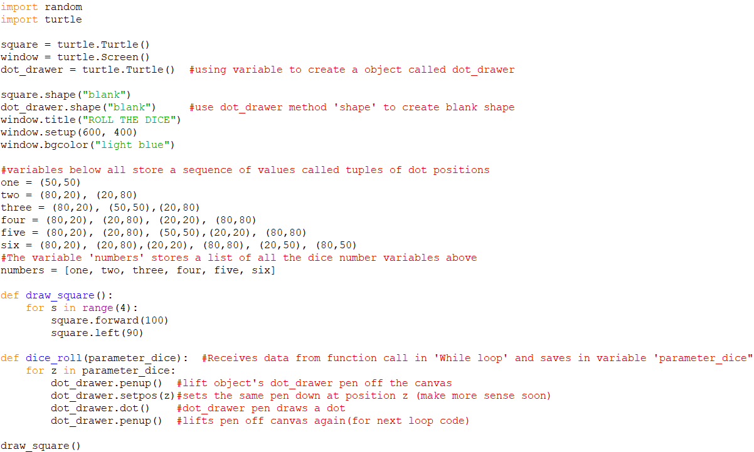
Rework our earlier dice_roll function
This function is called from main loop (next slides) and uses a for loop and the dice number to display the appropriate dot pattern

Slide 26
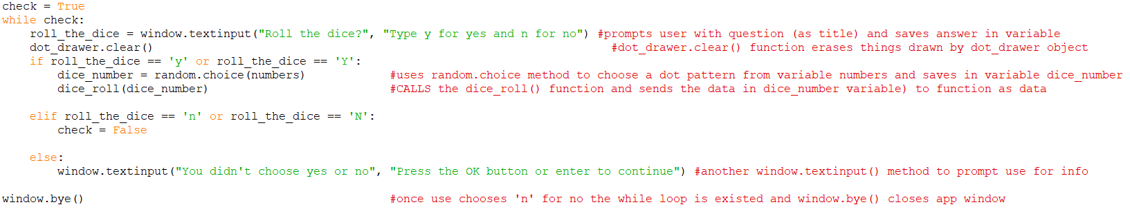
Fill in main while loop to continually check 3 possibilities(using if/elif/else)
The main loops job is to check for a ‘y’ to roll the dice and then it calls the dice_roll() function to draw the appropriate dots

Slide 27
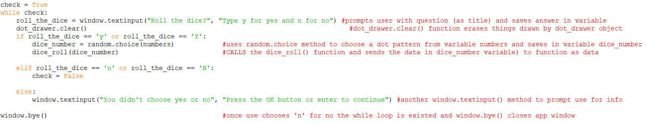
Fill in main while loop to continually check 3 possibilities(using if/elif/else)

Slide 28
Complete Code

Slide 29
Where to from here?
There are so many resources on the internet and youtube videos. The site below w3schools is great for learning about python
https://www.w3schools.com/python/default.asp
If you are looking for free books the following are good:
http://greenteapress.com/thinkpython2/thinkpython2.pdf
If you are interested in making python games using the pygame module see:
https://inventwithpython.com/makinggames.pdf

Slide 30
Glossary
Argument - a value sent or passed into a function
Comparison Operator – Check to see if something is true e.g. x == y, x >=y etc
Conditionals – statements that tell a program to execute different actions depending on whether a condition is true or false. If/elif/else are all conditional statements“
Function - a function is a named sequence of statements that performs a computation or job.
Integer - a whole number data type (int)
Loops – a programming structure that repeats a sequence of instructions until a specific condition is met. (for and while loops are examples)
Method - A function that is associated with an object and called using a dot and the object name (e.g window.title(‘ROLL THE DICE’) window is the object and title is the method)
Module – A python file containing a set of functions that you want to include in your own code or application (a code library)
Object – a thing created from method templates from a module (and classes not explained here). Often we use a variable to create an object which connects a modules methods to the object which we can use to make a defineable object e.g import turtle → window = turtle.Screen() → window.setup(600,400) window is the object and can use turtle screen methods to draw a window of size 600 X 400
Parameter - is a variable defined in a function that receives data value (argument) coming from a function call
Script - a python file with python code written in an editor and saved with file extension .py
Shell - Also known as Python Interactive Shell) which is used to execute a single Python command and get the result or
String – Text data (str)
Tuple - A sequence of values (can be saved in a variable)
Variable – a place holder in short term memory(RAM) we can use to store a data value or indeed some code

Slide 31
Thank you for coming to
Casey Tech School

